Slide 1


Distributed Execution Engine
Welcome To This Presentation
BIG DATA ANALYTICS
Abdul Saboor

Slide 2
The Agenda for Presentation
Point # 1
DEE
Point # 2
Dryad
Point # 3
Nephele
Point # 4
MapReduce
Point # 5
Pregel
Point # 6
Hyracks
BIG DATA ANALYTICS
1

Slide 3
What are Distributed Execution Engines?
DEEs are software systems that run on a cluster of network computer
High performance DEE for coarse-grained data Parallel applications
Allows developers to create large scale distributed applications
Draw a graph of the data dependencies of their algorithm
Each computer in these systems is capable of data- dependent control flow
    Effectiveness computational power of a DEE is determined by expressiveness of execution model
DEEs provide shield to developers in terms of challenging aspects of distributed and parallel computing
BIG DATA ANALYTICS
2

Slide 4
The Main characteristics of Distributed
Execution Engines
Task Scheduling
Transparent Fault tolerance
1
4
Data Distribution
2
Control Flow
5
Dependencies Tracking
Load Balancing
6
3
BIG DATA ANALYTICS
3

Slide 5
Types of Systems
DAG Batch Processing Systems
DAG Batch Processing Engines let the data flow between different operators or user defined code parts and scuffle the data as it necessary to partition as needed for join.
Streaming Systems
Streaming systems can’t afford to handle huge chunk and do complex analysis on them until they are done. They also need to response quickly and have some mechanism in place for that.
Bulk Synchronous Parallel
BSP system let data parts “talk” to each other as in Pregel vertices and send messages to their neighbors. They can do certain thing more naturally and efficiently, and exploit some dependencies in the data.
BIG DATA ANALYTICS
4

Slide 6
Batch Systems : Optimal Scheduling & Processor Optimization
Main Characteristics of Batch Systems
A set of Job – Each job is characterized by its execution time
Dependency relationship – a job cannot start unless and until each and every job on which it is dependent is completed
A dependency relationship is represented by as a Directed Acyclic Graph (DAG)
Batch completion time constraints – Batch execution should finish before batch finish time
Resource constraint – There is threshold on a maximum amount of resources that could be used at a point of time
BIG DATA ANALYTICS
5

Slide 7
Types of DEE and their Representations
1
Dryad Or Dryad LINQ
DAG
2
Nephele
DAG
3
MapReduce
DAG
4
Pregel
BSP
5
Hyracks
DAG
BIG DATA ANALYTICS
6

Slide 8
The Problem!
How can we make it easier for developer to write efficient and parallel distributed applications?
Resource allocation
Scheduling
Component failure
Concurrency control
BIG DATA ANALYTICS
7

Slide 9
Dryad Execution Engine
BIG DATA ANALYTICS

Slide 10
What is Dryad ?
Representation Arrows
Data Flow Graph
Execute Vertices
Vertices
Channels
Vertices
Channels
Communicate Through
Channels
Sequential Programs given by
Programmers
Files, TCP pipe, Shared memory FIFO
BIG DATA ANALYTICS
8

Slide 11
The Possible Solution : Dryad
Efficient way for parallel and distributed applications
Data Parallelism
Schedule across resources
Optimise the level of concurrency in a node
Manage failure resilience
Delivers data where needed
Higher level of abstraction has been built on Dryad
Takes advantage of multi-core servers
BIG DATA ANALYTICS
9

Slide 12
DRYAD Goals
Similar goals as MapReduce
Automatic management of scheduling, data distribution, fault tolerance
Focus on throughput, not latency
Computations expressed as a graph
Vertices are computations
Edges are communication channels
Each vertex has several input and output edges
BIG DATA ANALYTICS
10

Slide 13
Why Dryad using a Data-Flow graph?
Many programs can be represented as a distributed Data-flow graph
The Programmer may not have to know this
“SQL-Like”, Queries : LINQ
Dryad will run them automatically for users
BIG DATA ANALYTICS
11

Slide 14
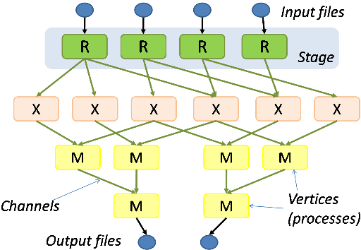
Job Structure of Dryad System
Represent the computations as a DAG of
Communicating sequential processes
BIG DATA ANALYTICS
12

Slide 15
Dryad System Overview
Dryad is collection of Processes that communicate
with one another through unidirectional channels
Each Dryad job is direct acyclic multi-graph, node
represent processes, and edges represent
communication channels
It handles reliable execution of the graph on a cluster
It schedules computations to computers and monitor
their executions
Dryad jobs execute in a shared-nothing environment
Where there is shared memory or disk state between
various processes
Vertices only communication medium between
process are the channels
Continues - - -
BIG DATA ANALYTICS
13

Slide 16
Dryad System Overview
Data Channel Protocols | Explanation
File (the default) | Preserved after vertex execution until the job completes
TCP pipe | Requires no disk accesses, but both end-point vertices must be schedule to run at the same time
Shared-memory FIFO | Extremely low communication cost, but end-point vertices must run within the same process
BIG DATA ANALYTICS
14

Slide 17
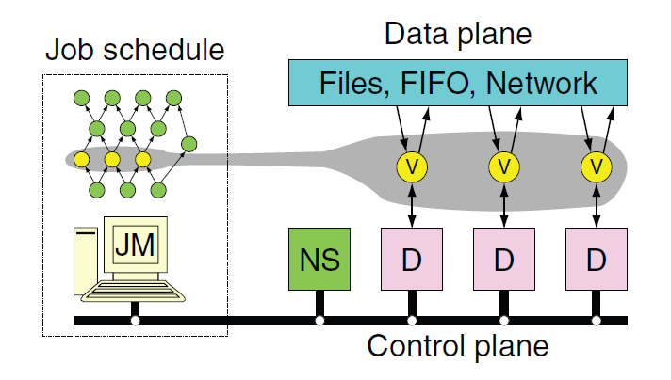
Components of Dryad System – 1
Name server enumerates all resources
Including location relative to other
resources
Daemon running on each machine for vertex dispatch
BIG DATA ANALYTICS
15

Slide 18
Components of Dryad System – 2
Vertices (V) run arbitrary app code
2. Vertices exchange data through files, TCP pipes, etc.
3. Vertices communicate with JM to report status
1 - Job Manager (JM) consults Name Server (NS)
2 - JM maintain job graph and schedules vertices
Daemon process (D) execute vertices
BIG DATA ANALYTICS
16

Slide 19
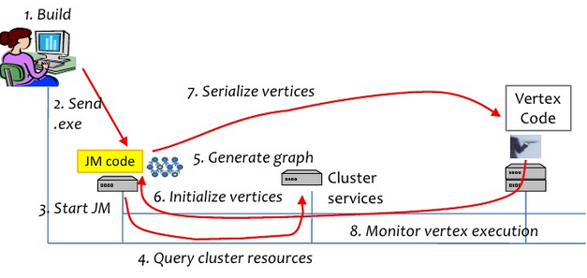
Components of Dryad System
BIG DATA ANALYTICS
17

Slide 20
Dryad Scheduler (JM) is a state machine
Static optimizer builds execution graph
Vertex can run anywhere once all its inputs are ready
Prefer executing a vertex near its inputs
Dynamic optimizer mutates running graph
Distributes codes, routes data
Schedule processes on machines near data
Adjust the available computer resources at each stage
Continues - - -
BIG DATA ANALYTICS
18

Slide 21
Dryad Scheduler (JM) is a state machine
Automatically recovers computations, adjusts for overloads (Fault Tolerance)
For example; If A fails, run it again
If A’s input are gone, run upstream vertices again (recursively)
If A is slow, run a copy elsewhere and use output from one that finish first
Masks failure in cluster and network
BIG DATA ANALYTICS
19

Slide 22
Dryad Job Execution
Job Manager is not a fault tolerant
Vertices may be schedule multiple time
Each execution versioned
Execution record kept-including version of incoming vertices
Outputs are uniquely named (Versioned)
Final outputs selected if job completes
Non-file communication may cascade failures
BIG DATA ANALYTICS
20

Slide 23
Advantages of DAG over MapReduce
Big jobs more efficient with Dryad
Dryad – Each job is represented with a DAG
Intermediate Vertices write to local file
Dryad Provides explicit joins – Explicit join
combine input of different types
Dryad Split produces different types of output
Parse a document, output text and preferences
MapReduce – Big jobs run >= 1 MR stages
Reducers of each stage write to replicate storage
Mapper (or Reducer) needs to read from shared table(s) as a substitute for join
BIG DATA ANALYTICS
21

Slide 24
Dryad LINQ
BIG DATA ANALYTICS
22

Slide 25
DryadLINQ : An Introduction
DryadLINQ is a set of language extensions that enable a new programming model for writing large-scale data parallel applications running on large PC clusters
It generalizes previous execution environment such as;
SQL
MapReduce
Dryad
DryadLINQ combines two important piece of Microsoft technology
Dryad Distributed Execution Engine
.NET Language Integrated Query (LINQ)
BIG DATA ANALYTICS
23

Slide 26
DryadLINQ = Dryad + LINQ
The Solution : DryadLINQ
DRYAD
Distributed computing infrastructure
Automatic recovery from failure
Automatic scheduling and data locality
High performance/scalability
Dryad is used by product group: one cluster is 3600 CPUs with 3.6 Petabytes of disk
LINQ
Easy expression of massive parallelism
Sophisticated, unified data model
Access to both library and custom code
Simple programming and debugging
LINQ is already available in Visual Studio
BIG DATA ANALYTICS
24

Slide 27
DryadLINQ System Architecture
Client machine
Data center
.NET program
DryadLINQ
Query Expr
Distributed
query plan
Invoke
Query
Vertex
code
To Dryad Table
Input Tables
JM
Dryad Execution
.Net Objects
Output
DryadTable
Result
Foreach
(11)
Output Tables
BIG DATA ANALYTICS
25

Slide 28
Nephele Distributed Execution Engine
BIG DATA ANALYTICS
26

Slide 29
Nephele Execution Engine
Execute Nephele schedules
Dryad style execution engine
Evaluates dataflow graphs in parallel
Data is read from distributed file system
Flexible engine for complex jobs
Design Goals
Exploit scalability/flexibility of clouds
Provide predictable performance
Efficient execution on 1000+ cores
Flexibility fault tolerance mechanisms
BIG DATA ANALYTICS
27

Slide 30
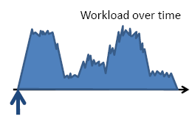
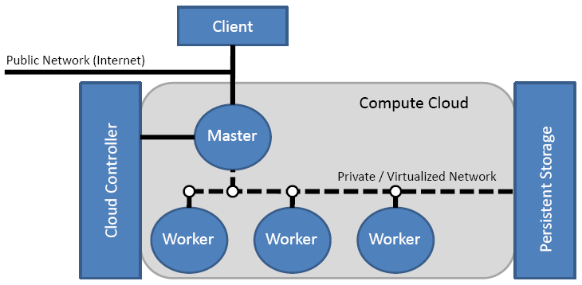
Nephele Architecture
Standard master worker pattern
Workers can be allocated on
demand
BIG DATA ANALYTICS
28

Slide 31
Structure of Nephele Schedule
Nephele schedule is represented as DAG
Vertices represent tasks
Edges denote communication channels
Mandatory information for each vertex
Task Program
Input / Output data location (I/O vertices only)
Optional Information for each vertices
Number of subtasks (degree of parallelism)
Number of subtasks per virtual machine
Types of Virtual machines (# CPU core, RAM ...)
Channel Types
Sharing virtual machines among tasks
Output 1
Task: LineWriterTask.Program
Task 1
Task: MyTask.Program
Input 1
Task: LineReaderTask.Program
BIG DATA ANALYTICS
29

Slide 32
Execution Stages
Execution Stage
Stage 1
Issues with on-demand allocation
When to allocate virtual machine?
When to de-allocate virtual machine?
No guarantee of resource availability!
Stages ensure three properties
VMs of upcoming stage are available
All workers are setup and ready
Data of previous stages is stored in persistent manner
Group Vertex
Input 1 (1)
ID: 2
Type: m1.large
Execution Instance
Execution Vertex
Task 1 (2)
Stage 0
ID: 21
Type: m1.small
Input 1 (1)
BIG DATA ANALYTICS
30

Slide 33
Channel Types
Stage 1
Network channels (Pipeline)
Vertices must be in Same stage
In-memory channels (Pipeline)
Vertices must run on Same VM
Vertices must be run in Same stage
File Channels
Vertices must run on Same VM
Vertices must be run in Different stages
Input 1 (1)
ID: 2
Type: m1.large
Task 1 (2)
Stage 0
ID: 21
Type: m1.small
Input 1 (1)
BIG DATA ANALYTICS
31

Slide 34
Map Reduce Execution Engine
BIG DATA ANALYTICS
32

Slide 35
MapReduce Architecture
Map
Reduce
Network
Map
Reduce
Map
Reduce
Map
Reduce
Map
Reduce
Distributed File System
BIG DATA ANALYTICS
33

Slide 36
MapReduce
A simple programming model that applies to many large-scale computing problems
Hide messy details in MapReduce runtime library
Automatic parallelization
Load balancing
Network and disk transfer optimization
Handling of machine failures
Robustness
Improvements to core library benefit all users of library
BIG DATA ANALYTICS
34

Slide 37
Typical Problem Solved by MapReduce
Read a lot of data
Map – Extract something you care about from each set of record
Shuffle and Sort
Reduce – Aggregate, summarize, filter or transform
Write the results
BIG DATA ANALYTICS
35

Slide 38
Stream Processing
MapReduced is often applied to streams of data that arrive continuously
Click streams, web crawl data, network traffic, ...
Traditional approach: buffer, batch process
Poor latency
Analysis state must be reloaded
Run MR jobs continuously and analyse data as it arrives
BIG DATA ANALYTICS
36

Slide 39
MapReduce in Specific Context
Programmer need to specify two primary methods
Map (K,V) → <K`, V`>*
Reduce (K`, <V`>* →(K`, V`>*
All V` with same K` are reduced together, in order
Also Specify
        Partition(K`, total partitions) → partition for K`
A simple hash of the key often
Allows reduce operations for different K` to be parallelized
BIG DATA ANALYTICS
37

Slide 40
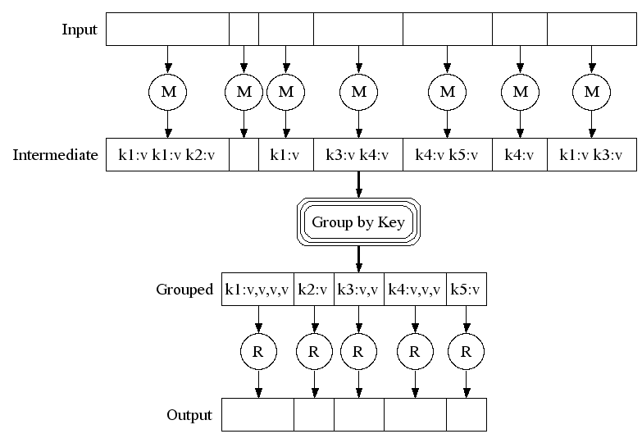
MapReduce in a Nutshell
Map (k1, v1) → list(k2, v2)
Processes one input key/value pair
Produces a set of intermediate
key/value pairs
Reduce (k2, list(v2))→ list(k3, v3)
Combines intermediate
values for one particular key
Produces a set of merged
output values (usually one)
BIG DATA ANALYTICS
38

Slide 41
MapReduce - Scheduling
One Master, many Workers
Input data split into M map tasks (typically 64 MB in size)
Reduce phase partitioned into R reduce tasks
Tasks are assigned to workers dynamically
Master assign each map task to a free worker
Considers locality of data to worker when assigning task
Worker reads task input (often from local disk) Worker produces R local files containing intermediate K/V pairs
Master assigns each reduce task to a free worker
Worker reads intermediate K/V from map workers
Worker sorts and applies user’s Reduce output to produce the output
BIG DATA ANALYTICS
39

Slide 42
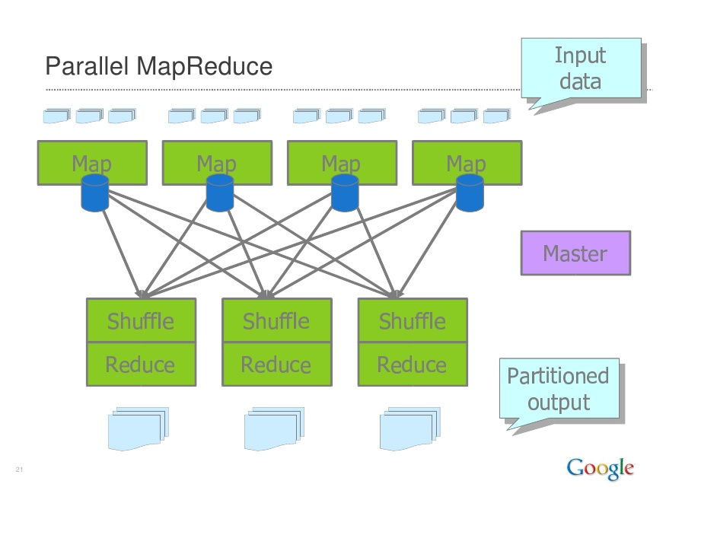
MapReduce Parallelism
← Hash Partitioning
BIG DATA ANALYTICS
40

Slide 43
Fault Tolerance – Handled via re-execution
On Worker failure
Detect failure via periodic flow (heartbeats)
Re-execute completed and in-progress map tasks
Re-execute in progress reduce tasks
Task completion committed through master
On Master failure
State is checkpointed to GFS – new master recovers and continues
Very Robust – lost 1600 of 1800 machine once, but finished was fine
BIG DATA ANALYTICS
41

Slide 44
MAP REDUCE
PROS
Very fault-tolerant and automatic load balancing
Operates well in heterogeneous clusters
CONS
Writing MapReduce jobs is more complicated then writing SQL queries
Performance depends on the skill of the programmer
BIG DATA ANALYTICS
42

Slide 45
Hadoop MapReduce
Apache Project
Hadoop is an open-source software for reliable, scalable and distributed computing. Hadoop is a scalable fault-tolerant distributed system for data storage and processing.
Apache Hadoop includes
Map/Reduce execution engine
Hadoop distributed file system (HDFS)
Several additional subprojects
Scalable data processing engine
HDFS – Self-healing high bandwidth clustered storage
MapReduce – Fault-tolerant distributed processing
BIG DATA ANALYTICS
43

Slide 46
Hadoop MapReduce
Hadoop MapReduce
Map/Reduce programming interface
Map/Reduce execution engine
Massive Parallelization (10000+ Computer nodes)
Fault-tolerance (Recover from node failure)
Auxiliary services beyond pure map/reduce
Distributed Cache
Key Values
Flexibility – Store data without a schema and add it later as needed
Affordable – Cost per TB at a fraction of traditional options
Broadly adopted – A large and active ecosystem
Proven at scale – Dozens of petabyte + implementation in production today
BIG DATA ANALYTICS
44

Slide 47
Hadoop Analysis
Nature of Analysis
What Analysis is Possible?
Batch Processing
Parallel execution
Spread data over a cluster servers and take the computation to the data
Text Mining
Index building
Graph creation & analysis
Pattern recognition
Collaborative filtering
Prediction models
Risk assessment
Sentiment analysis
BIG DATA ANALYTICS
45

Slide 48
PREGEL EXECUTION ENGINE
BIG DATA ANALYTICS
46

Slide 49
Google Pregel
Distributed system especially developed for large scale graph processing
Intuitive API that let’s you, think like a vertex
Bulk Synchronous Parallel (BSP) as execution model
Fault tolerance by checkpointing
BIG DATA ANALYTICS
47

Slide 50
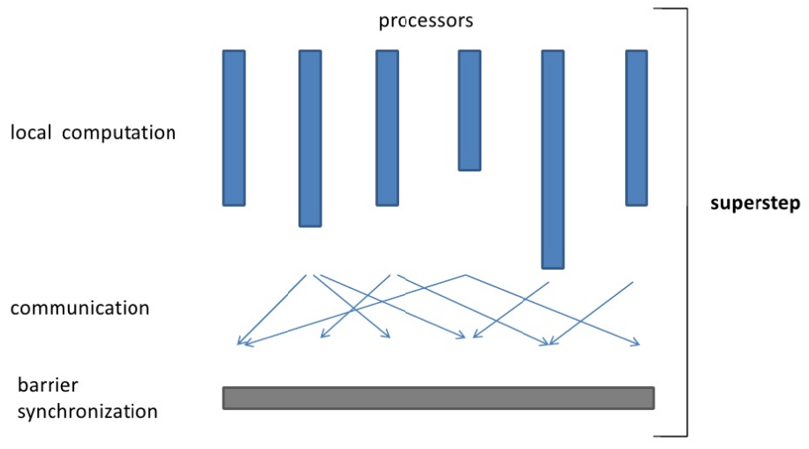
Bulk Synchronous Parallel
BIG DATA ANALYTICS
48

Slide 51
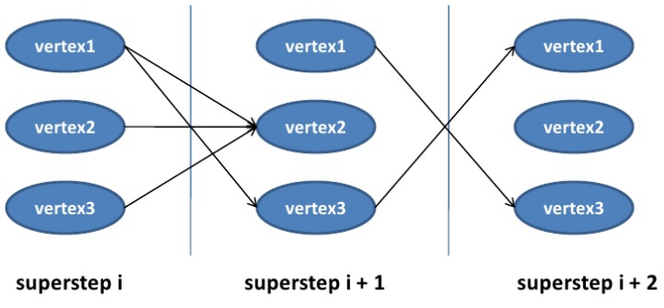
BSP Vertex-Centric
Each vertex has an ID, a value, a list of its adjacent vertex Ids, and the corresponding edge values
Each vertex is invoked in each superstep, can re- compute its value and send messages to other vertex, which are delivered over superstep barriers
Advanced features: termination votes, aggregators, ...
BIG DATA ANALYTICS
49

Slide 52
Bulk Synchronous Parallel (BSP)
Series of iterations (supersteps)
Each vertex invokes a function in parallel
Can read messages sent in previous supersteps
Can send messages, to be read at the next superstep
Can modify the state of outgoing edges
BIG DATA ANALYTICS
50

Slide 53
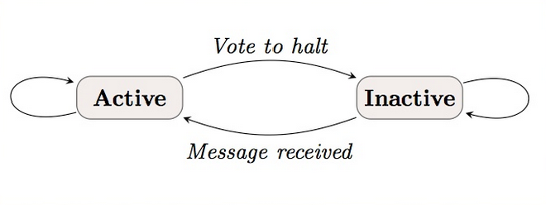
Pregel Compute Model
You give Pregel a directed graph
It runs your computation at each vertex
Do this process until every vertex votes to halt
Pregel gives you a directed graph back
Vertex State Machine
BIG DATA ANALYTICS
51

Slide 54
Fault Tolerance
At each superstep S:
Worker checkpoints V, E and messages
Master checkpoint aggregators
If a node fails, everyone start over at S
Confined recovery is under development
What happens if the Masters fails?
BIG DATA ANALYTICS
52

Slide 55
HYRACKS EXECUTION ENGINE
BIG DATA ANALYTICS
53

Slide 56
Why Hyracks?
Data sizes are growing exponentially
Web – Trillions of URLs
Social Networks (Facebook – 500M Active Users, More than 50M status updates per day)
Data is not necessarily flat
Semi-structure data
Unstructured data
Different data models (e.g., Arrays)
Non-traditional treatment of data
Need for processing data using custom logic
BIG DATA ANALYTICS
54

Slide 57
Motivation for Hyracks
Large cluster of commodity hardware feasible
Google claims 10000s of cheap computers in their cluster
Fast networks are commodity
1 GB already available
10 GB available soon
Last but not least : Attention from industry
Plenty of new and interesting use-cases
BIG DATA ANALYTICS
55

Slide 58
Hyracks Architecture
Cluster Controller
Network
Node Controller
Node Controller
Node Controller
Node Controller
BIG DATA ANALYTICS
56

Slide 59
Hyracks Main Steps
Fine-grained fault tolerance / recovery
  Restart failed jobs in a more fine-grained manner
  Exploit operator properties (natural blocking points) to get fault-tolerance at marginal (or no) extra cost
Automatic Scheduling
  Use operator resource needs to decide sites for operator evaluation
Define protocol for interacting with HLL query planners
BIG DATA ANALYTICS
57

Slide 60
The Usage Scenarios of Hyracks
Designed with three possible uses in mind
High level data language compilation target
Compile directly to Native Hyracks job
Compile to Hadoop jobs and run using
compatibility layer
Run Hadoop jobs from existing Hadoop clients
Run Native Hyracks job
BIG DATA ANALYTICS
58

Slide 61
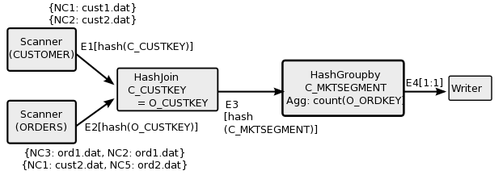
Hyracks Jobs
Job = Unit of work submitted by a Hyracks clients
Job = dataflow DAG of operators and connectors
Operators consume / produce partitions of data
Connectors repartition / route data between operators
An Example
BIG DATA ANALYTICS
59

Slide 62
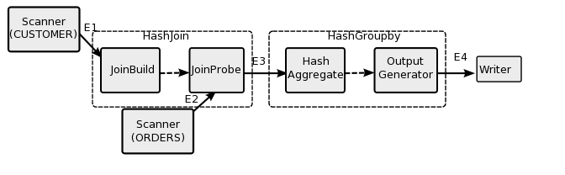
Hyracks : An Example of Operator Activities
BIG DATA ANALYTICS
60

Slide 63
Hyracks Data Movement
Fixed size memory blocks used to transport data
Cursors to iterate over serialize data
Common operations (comparison/hashing/projection) can be performed directly on data in frames
Goals : Keep garbage collection to a minimum and minimize data copies
According to given evidence (Anecdotally) : Run queries for Apx. 60 minutes, the total GC time Apx. 1.8 s.
BIG DATA ANALYTICS
61

Slide 64
Hyracks Operator/Connector Design
Operations on Collections of Abstract Data Types
Data model operations are provided during instantiation
For example
  Sort operator accepts a list of comparators
  Hash-based Groupby accepts a list of hash- functions and a list of comparators
  Hash-Partitioning connector accepts a hash- function
BIG DATA ANALYTICS
62

Slide 65
Hyracks Operator/Connector Interface
Uniform push-style iterator interface that accept ByteBuffer objects
Data model operations are provided during instantiation
public interface IFrameWriter {
public void open() …;
public void close() …;
public void nextFrame(ByteBuffer frame)…;
}
BIG DATA ANALYTICS
63

Slide 66
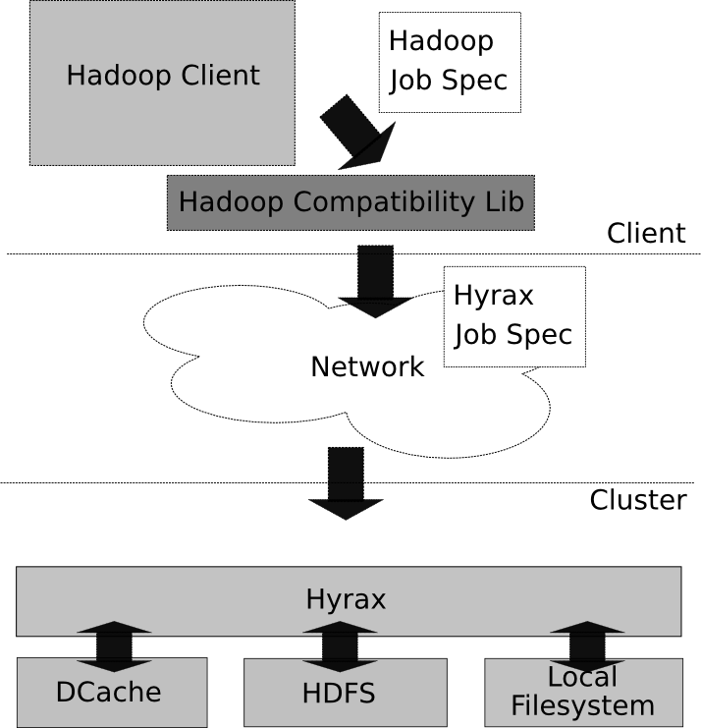
Hadoop Compatibility Layer
GOAL
Run Hadoop jobs unchanged on top of Hyracks
HOW
Clients-side library converts a Hadoop job spec into an equivalent Hyracks job spec
Hyracks has operator to interact with HDFS
Dcache provides distributed cache functionality
BIG DATA ANALYTICS
64

Slide 67
Hyracks vs Alternatives
Parallel Databases
Hadoop
Dryad
Extensible Data Model
Fault Tolerance
More flexible computational model
Generalize runtime processing model
Better support (transparency) for scheduling
Data as a first class citizen
Commonly occurring Data operators
Support common data communication patterns
BIG DATA ANALYTICS
65

Slide 68
The Summary of Key Features
Task Scheduling
Load Balancing
Data Distribution
Transparent Fault Tolerance
BIG DATA ANALYTICS
66

Slide 69

Thanks For Yours Attentions
Any Questions ?
BIG DATA ANALYTICS

Slide 70
References
1. M. Isard, M. Budiu, Y. Yu, A. Birrell, and D. Fetterly. Dryad: distributed data- parallel programs from sequential building blocks. In EuroSys ’07: In Proceedings of the 2nd ACM SIGOPS/EuroSys European Conference on Computer Systems 2007, pages 59–72, New York, NY, USA, 2007. ACM.
2. D. Warneke and O. Kao. Nephele: Efficient Parallel Data Processing in the Cloud. In I. Raicu, I. T. Foster, and Y. Zhao, editors, SC-MTAGS. ACM, 2009.
J. Dean and S. Ghemawat, “MapReduce: Simplified data processing on large clusters,” in OSDI ’04, December 2004, pp. 137–150. [Online]. Available: ttp://www.usenix.org/events/osdi04/tech/dean.html
4. Y. Yu, M. Isard, D. Fetterly, M. Budiu, U . Erlingsson, P. K. Gunda, and J. Currey. DryadLINQ: A system for general-purpose distributed data-parallel computing using a high-level language. In Proceedings of the 8th Symposium on Operating Systems Design and Implementation (OSDI), December 8-10 2008.
5. D. Battre ́, S. Ewen, F. Hueske, O. Kao, V. Markl, and D. Warneke, “Nephele/ PACTs: a programming model and execution framework for web-scale analytical processing,”inSoCC. NewYork,NY,USA:ACM, 2010, pp. 119–130.
6. D. Borthakur. The Hadoop Distributed File System: Architecture and Design, 2007.
7. V. Borkar, M. Carey, R. Grover, N. Onose, and R. Vernica, “Hyracks: A
flexible and extensible foundation for data-intensive computing – long
version,” Available from http://asterix.ics.uci.edu.
8. “Apache Hadoop website,” http://hadoop.apache.org.
9. “ASTERIX Website,” http://asterix.ics.uci.edu/.
10. DryadLINQ Research Home Page, http://research.microsoft.com/en-us/ projects/dryadlinq/
11. DryadLINQ: A System for General-Purpose Distributed Data-Parallel Computing Using a High-Level Language http://research.microsoft.com/en-us/projects/ dryadlinq/dryadlinq.pdf
BIG DATA ANALYTICS

