Slide 1

GASiC: Metagenomic abundance estimation and diagnostic testing on species level
Martin Lindner, Bernhard Renard
NG 4, Robert Koch-Institut

Slide 2
Contents
Motivation
  What is Metagenomics?
  Focus: Abundance Estimation
GASiC Method
  Mapping
  Genome Similarity Estimation
  Similarity Correction
Comparison, Application
Technical Details
  Current Status
  GASiC and SeqAn

Slide 3

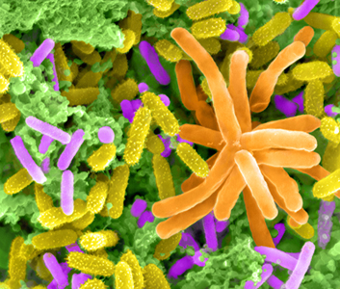
What is Metagenomics?
Analysis of genomic material directly taken from environmental samples.
vs.
Purified Escherichia coli
[Rocky Mountain Laboratories, NIAID, NIH]
Lake Washington Microbes
[Dennis Kunkel Microscopy, Inc.]
Identify contributors of special functions
Study interaction of microbes
Estimate microbial diversity
Highly complex samples
Mostly unknown organisms
High spatial/temporal variability

Slide 4
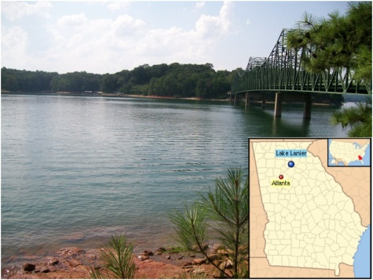
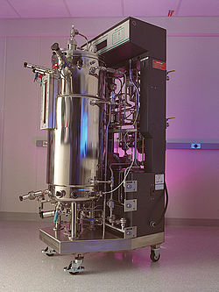
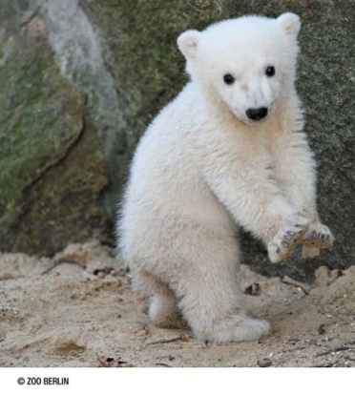
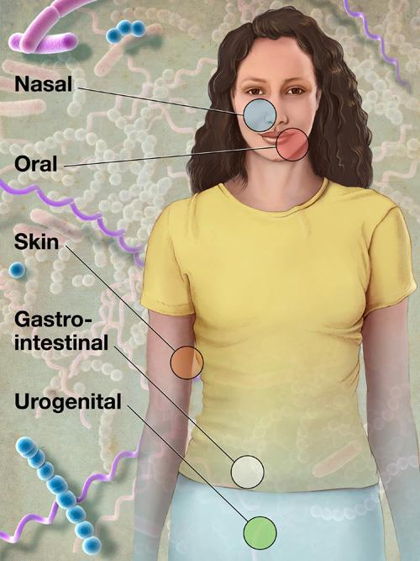
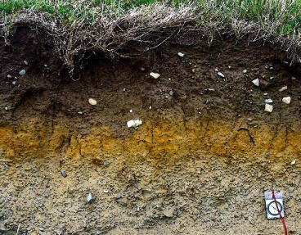
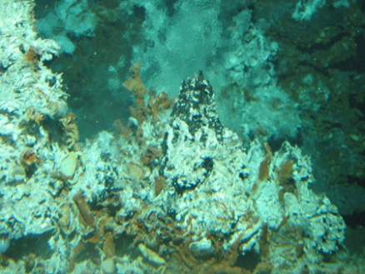
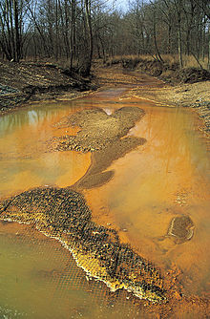
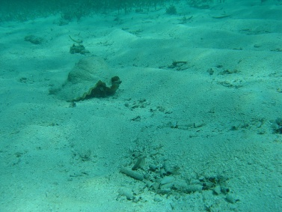
Metagenomic Communities
Lake Lanier (USA)
Bioreactor
Famous polar bear
Soil
Hydrothermal vents
Human microbiome
Acid mine drainage
Marine sediments
Low Complexity
High Complexity
Number of Microbial Species:
1
10
100
1000
10000

Slide 5
Bioinformatics in Metagenomics
Genome assembly
Gene/function prediction
Taxonomic profiling
Interaction networks
Focus on Taxonomic profiling:
Who is out there? And, how many?

Slide 6
Taxonomic Profiling
Reference based
Clinical Applications
High accuracy
Narrow focus
Comparative Metagenomics
Abundance
Estimation
Diversity Estimation
Exploration
& Assembly
Low accuracy
Broad focus
Composition based

Slide 7
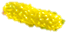


Genome Abundance Estimation
Goal:
Estimate relative abundance of organisms from metagenomic sequence reads
Problems:
(Reference genome unknown)
Unequal genome lengths
Genomic Similarity
Buchnera aphidicola: 0.64 M bp
Streptomyces bingchenggensis: 11.9 M bp
???

Slide 8
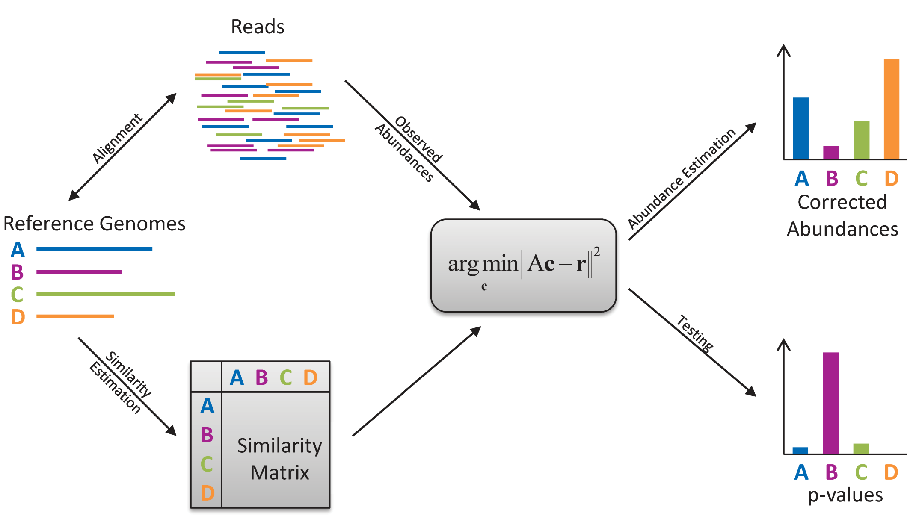
GASiC Method

Slide 9
1. Read Mapping
Chose suitable read mapper
Map reads against reference genomes
  Each genome separately
  Does it match? Yes/No
Write results to SAM-files

Slide 10
2. Similarity Estimation
Similarity matrix:
j
a_{ij} = Probability that a read from genome i can be mapped to genome j
A =
i
a_{ij}
How to obtain a_{ij}:
Simulate N reads from genome i (e.g. with Mason)
Map reads to genome j with same mapper/settings as in 1.
Count the number of mapped reads r_{ij}
a_{ij} = r_{ij}/r_{ii}

Slide 11


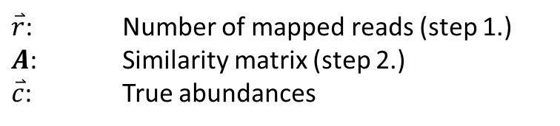


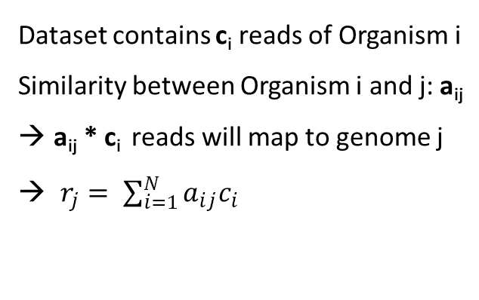
3. Similarity Correction
Linear Model:
Matrix notation:
Dataset contains c_{i} reads of Organism i
Similarity between Organism i and j: a_{ij}
a_{ij} * c_{i} reads will map to genome j
$r_{j}= \sum_{i=1}^{N}{a_{ij}c_{i}}$
$$\overset{⃑}{r}=A\overset{⃑}{c}$$
$\overset{⃑}{r}$: Number of mapped reads (step 1.)
$A$: Similarity matrix (step 2.)
$\overset{⃑}{c}$: True abundances
Linear Algebra lecture:
$$\overset{⃑}{c}=A^{−1}\overset{⃑}{r}$$

Slide 12
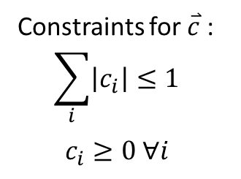


Solving $\overset{⃑}{r}=A\overset{⃑}{c}$
Approximate solution:
Constraints for $\overset{⃑}{c}$ :
$$\sum_{i}{\left|c_{i}\right|≤1}$$
$$c_{i}≥0 ∀i$$
$$\overset{⃑}{c}=\underset{\overset{⃑}{c′}}{argmin}{{\left\|A\overset{⃑}{c′}−\overset{⃑}{r}\right\|}_{2}}$$
Non-negative
LASSO
[Renard et al.]
Solve with standard solver for constrained optimization
GASiC: COBYLA from scipy package

Slide 13
Comparison
Metagenomic FAMeS dataset: [Mavromatis et al.]
113 microbial species
3 datasets with different complexities
100,000 Sanger reads (1000bp) per dataset
Ground truth available
Comparison by Xia et al.

Slide 14
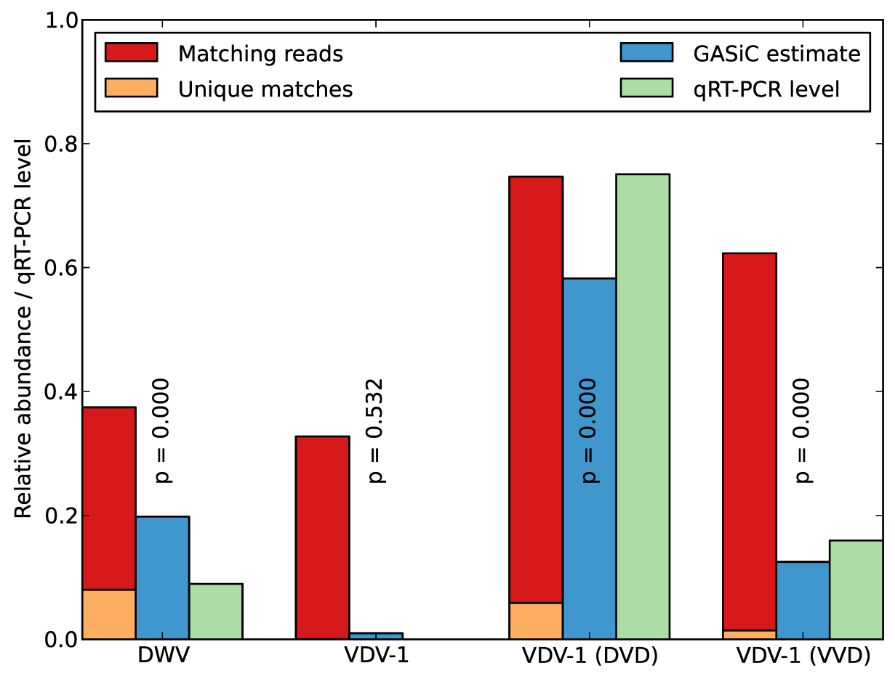
Application
Viral recombination data: [Moore et al.]
  4 viruses with 80%-96% sequence similarity
  Abundance estimates from biological experiments

Slide 15
Technical Details
Language: Python
  Use scipy/numpy packages
Platform: Linux (native)
Interfaces (command line) to:
  Read simulator (e.g. Mason [Holtgrewe])
  Read mapper (e.g. bowtie [Langmead et al.])

Slide 16
Technical Details
Reads
Genomes
Similarity Estimation
Mapping
Simulator
Mapper
write
Mapper
read
Sim. Reads
write
write
SAM
read+write
Similarity Matrix
SAM
read
read
Abundance Estimates
Similarity Correction

Slide 17

GASiC & SeqAn
Avoid disk IO!
Integrate all modules in one tool
Abandon dependences on external tools
→ SeqAn looks like a suitable framework!

Slide 18
Example: Similarity Matrix
Current implementation:
Simulate 100,000 reads and write to fastq file
Read file and map to ref. genome, write results to SAM file
Read SAM file and count the number of matching reads
The SeqAn way:
Simulate 1 read and map to ref. genomes; count if read mapped
Repeat 100,000 times

Slide 19
References
Method:
Lindner,M.S. and Renard,B.Y. (2012) Metagenomic abundance estimation and diagnostic testing on species level. Nucl. Acids Res., doi: 10.1093/nar/gks803.
Renard,B.Y. et al. (2008) NITPICK: peak identification for mass spectrometry data. BMC Bioinformatics, 9, 355.
Datasets:
Mavromatis,K. et al. (2007) Use of simulated data sets to evaluate the fidelity of metagenomic processing methods. Nat. Methods, 4, 495–500.
Moore,J. et al. (2011) Recombinants between Deformed wing virus and Varroa destructor virus-1 may prevail in Varroa destructor-infested honeybee colonies. J. Gen. Virol., 92, pp 156–161.
Related Methods:
Huson,D. et al. (2007) MEGAN analysis of metagenomic data. Genome Res., 17, 377–386.
Xia,L. et al. (2011) Accurate genome relative abundance estimation based on shotgun metagenomic reads. PLoS One, 6, e27992.
External Tools:
Langmead,B. et al. (2009) Ultrafast and memory-efficient alignment of short DNA sequences to the human genome. Genome Biol., 10, R25.
Holtgrewe,M. (2010) Mason – a read simulator for second generation sequencing data. Technical report TR-B-10-06. Institut für Mathematik und Informatik, Freie Universität Berlin.

Slide 20

Acknowledgements
Research Group Bioinformatics (NG4)
Bernhard Renard
Franziska Zickmann
Martina Fischer
Robert Rentzsch
Anke Penzlin
Mathias Kuhring
Sven Giese

