Slide 1
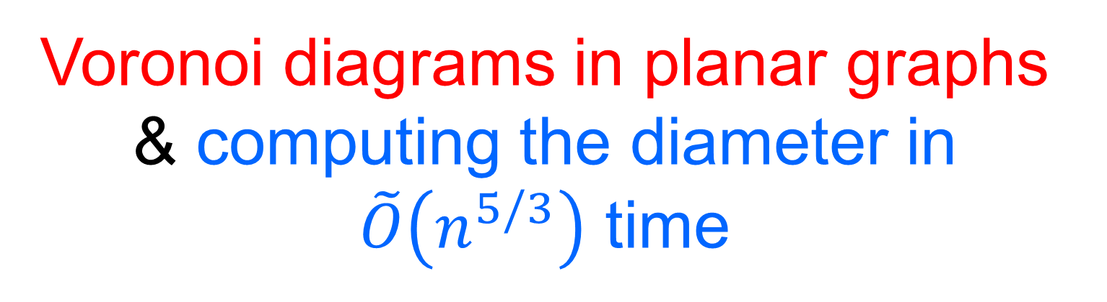
Voronoi diagrams in planar graphs & computing the diameter in $\tilde{O}\left(n^{5/3}\right)$ time
Pawel Gawrychowski, Haim Kaplan, Shay Mozes, Micha Sharir, and Oren Weimann

Slide 2

I will omit logarithmic factors without explicitly writing $\tilde{O}$…

Slide 3
Diameter
Compute the longest shortest path
Assume distinct distances, unique shortest paths

Slide 4
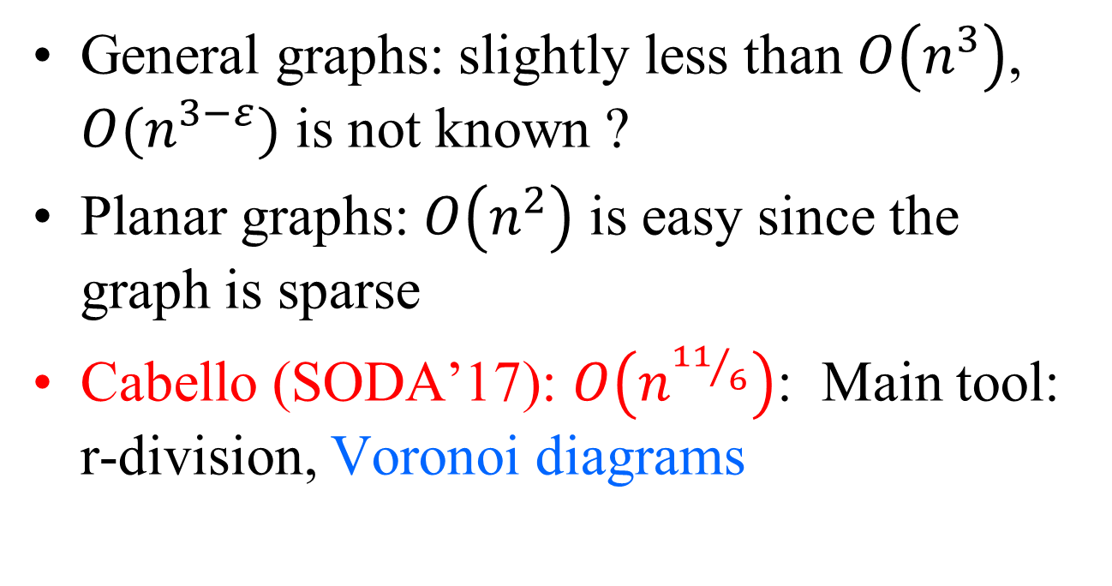
Diameter state of the art
General graphs: slightly less than $O\left(n^{3}\right)$, $O(n^{3−ε})$ is not known ?
Planar graphs: $O\left(n^{2}\right)$ is easy since the graph is sparse
Cabello (SODA’17): $O\left(n^{{11}/6}\right)$: Main tool: r-division, Voronoi diagrams

Slide 5

Our result
$O\left(n^{5/3}\right)$, using explicit Voronoi diagrams (rather than abstract ones: Klein 89/Mehlhorn, Klein and Meizer 93)

Slide 6
Overview of the diameter algorithm
Compute an r-division
Intuitively this is a recursive application of the planar separator theorem

Slide 7
r-division

Slide 8
r-division

Slide 9
r-division

Slide 10
r-division

Slide 11
A piece

Slide 12
Another piece

Slide 13
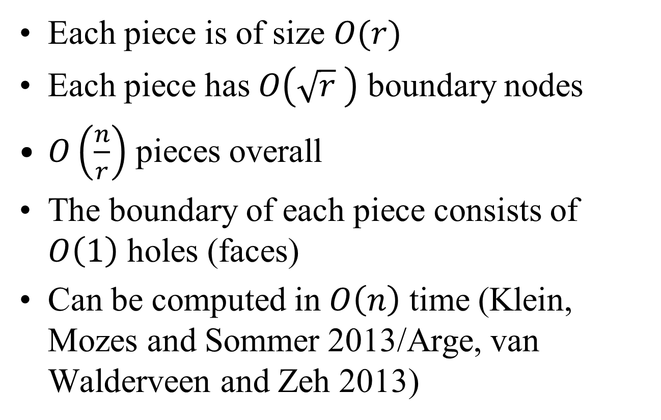
r-division (Fredrickson 87)
Each piece is of size $O(r)$
Each piece has $O\left(\sqrt{r} \right)$ boundary nodes
$O\left(\frac{n}{r}\right)$ pieces overall
The boundary of each piece consists of $O\left(1\right)$ holes (faces)
Can be computed in $O\left(n\right)$ time (Klein, Mozes and Sommer 2013/Arge, van Walderveen and Zeh 2013)

Slide 14
Three kinds of shortest paths
Between a vertex and a boundary vertex
Between two vertices inside the same piece
Between two vertices in different pieces

Slide 15

Dist. to/from boundary nodes
$$v$$

Slide 16
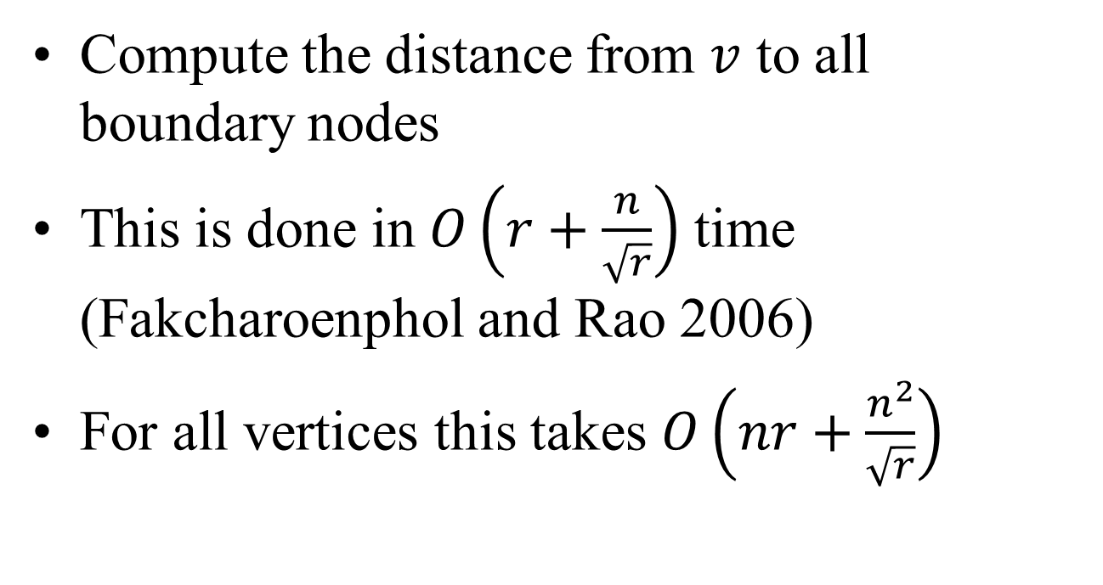
Distances to/from boundary nodes
Compute the distance from $v$ to all boundary nodes
This is done in $O\left(r+\frac{n}{\sqrt{r}}\right)$ time (Fakcharoenphol and Rao 2006)
For all vertices this takes $O\left(nr+\frac{n^{2}}{\sqrt{r}}\right)$

Slide 17
Between vertices in the same piece

Slide 18
Between vertices in the same piece
$$v$$

Slide 19
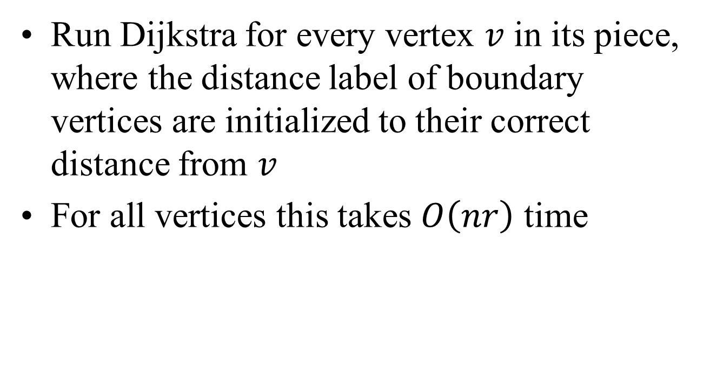
Inside pieces
Run Dijkstra for every vertex $v$ in its piece, where the distance label of boundary vertices are initialized to their correct distance from $v$
For all vertices this takes $O\left(nr\right)$ time

Slide 20

Vertices in diff. pieces
$$v$$
$$P$$

Slide 21
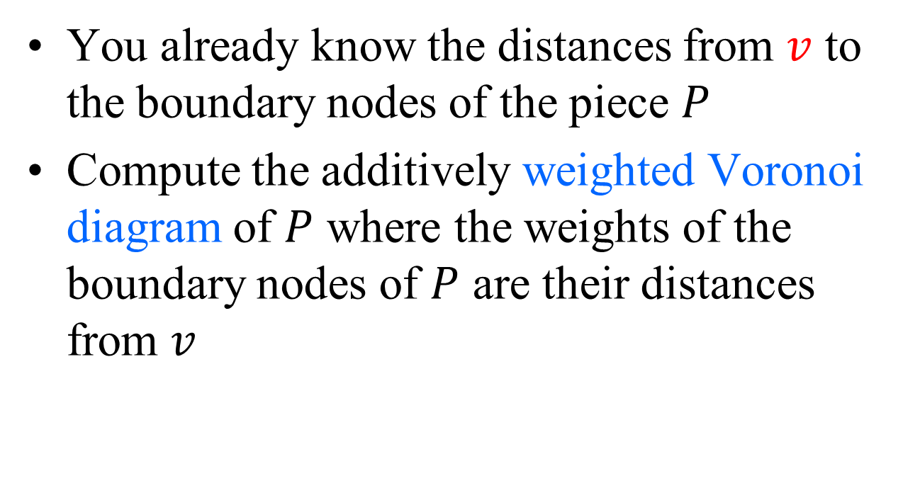
Between vertices in different pieces
You already know the distances from $v$ to the boundary nodes of the piece $P$
Compute the additively weighted Voronoi diagram of $P$ where the weights of the boundary nodes of $P$ are their distances from $v$

Slide 22

Voronoi diagram
$$v$$

Slide 23
Additively weighted Voronoi diagram

Slide 24
Voronoi diagram

Slide 25
Voronoi diagram

Slide 26
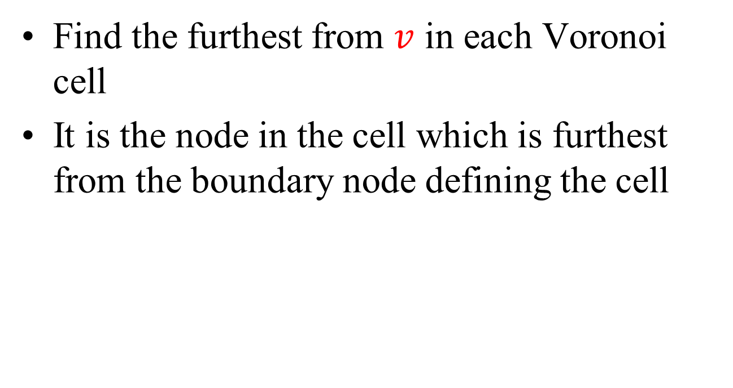
Maximum dist. between vertices in different pieces
Find the furthest from $v$ in each Voronoi cell
It is the node in the cell which is furthest from the boundary node defining the cell

Slide 27
Compute the furthest in each cell
$$v$$

Slide 28

Voronoi diagram + max in cells
Computing the weighted Voronoi diagram of $P$, and the max in each cell, takes $O\left(\sqrt{r}\right)$ time

Slide 29

Between vertices in different pieces
Total time for all Voronoi diagrams $O\left(n⋅\frac{n}{r}\sqrt{r}\right)$

Slide 30

Total time
$$O\left(nr+\frac{n^{2}}{\sqrt{r}}\right)$$
For $r=n^{2/3}$ this is $O\left(n^{5/3}\right)$

Slide 31
Representing the diagram

Slide 32
Voronoi vertices

Slide 33
Bisectors

Slide 34
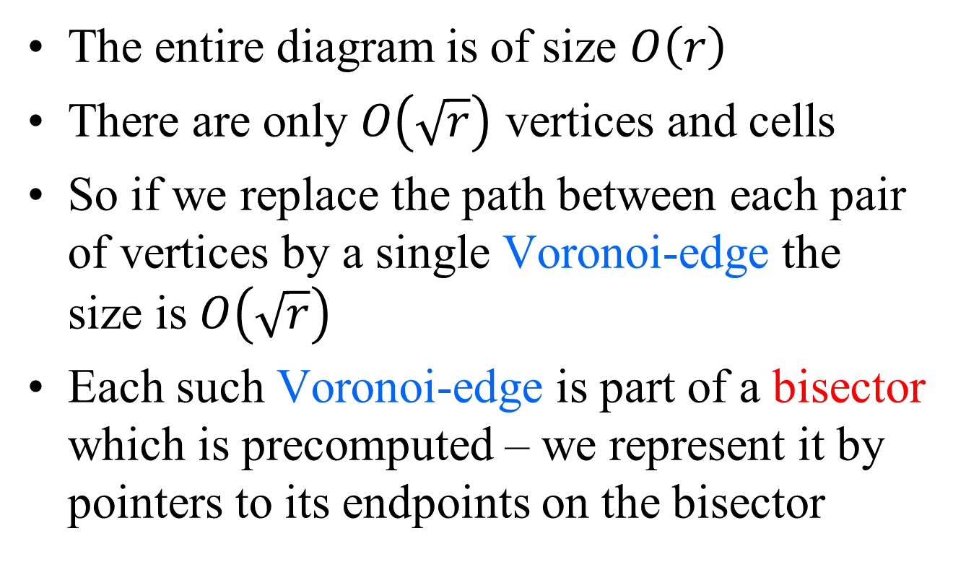
Representing the diagram
The entire diagram is of size $O\left(r\right)$
There are only $O\left(\sqrt{r}\right)$ vertices and cells
So if we replace the path between each pair of vertices by a single Voronoi-edge the size is $O\left(\sqrt{r}\right)$
Each such Voronoi-edge is part of a bisector which is precomputed – we represent it by pointers to its endpoints on the bisector

Slide 35

Compute the max from info on the bisectors
We compute the furthest from $v$ in each cell from information stored at the bisectors $O\left(|∂cell|\right), O\left(\sqrt{r}\right)$ for all cells

Slide 36
Computing the bisectors

Slide 37
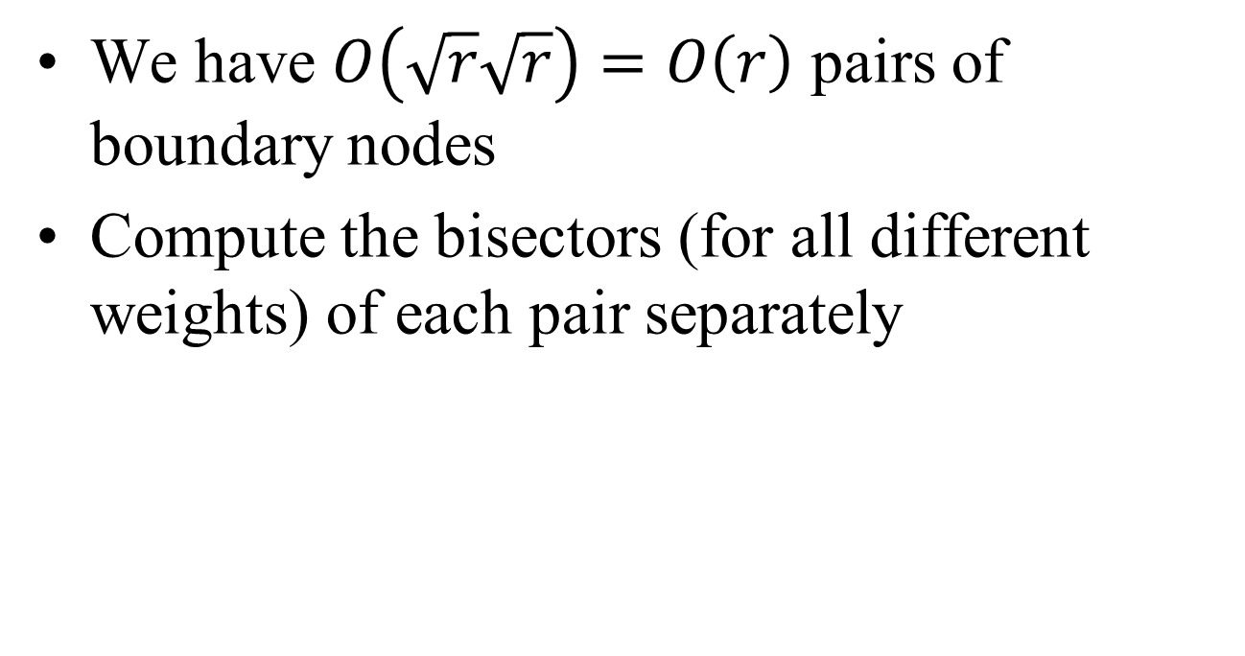
Computing the bisectors
We have $O\left(\sqrt{r}\sqrt{r}\right)=O\left(r\right)$ pairs of boundary nodes
Compute the bisectors (for all different weights) of each pair separately

Slide 38

Computing the Bisectors
$$∞$$

Slide 39
Computing the Bisectors
$$∞$$

Slide 40
Computing the Bisectors
$$∞$$

Slide 41
Computing the Bisectors
$$∞$$

Slide 42
Computing the Bisectors
$$∞$$

Slide 43
Computing the Bisectors
$$∞$$

Slide 44
Computing the Bisectors
$$∞$$

Slide 45
Computing the Bisectors
$$∞$$

Slide 46
Computing the Bisectors
$$∞$$

Slide 47
Computing the Bisectors
$$∞$$

Slide 48
Computing the Bisectors
$$∞$$

Slide 49
Computing the Bisectors
$$∞$$

Slide 50
Computing the Bisectors
$$∞$$

Slide 51
Computing the Bisectors
$$∞$$

Slide 52
Computing the Bisectors
$$∞$$

Slide 53
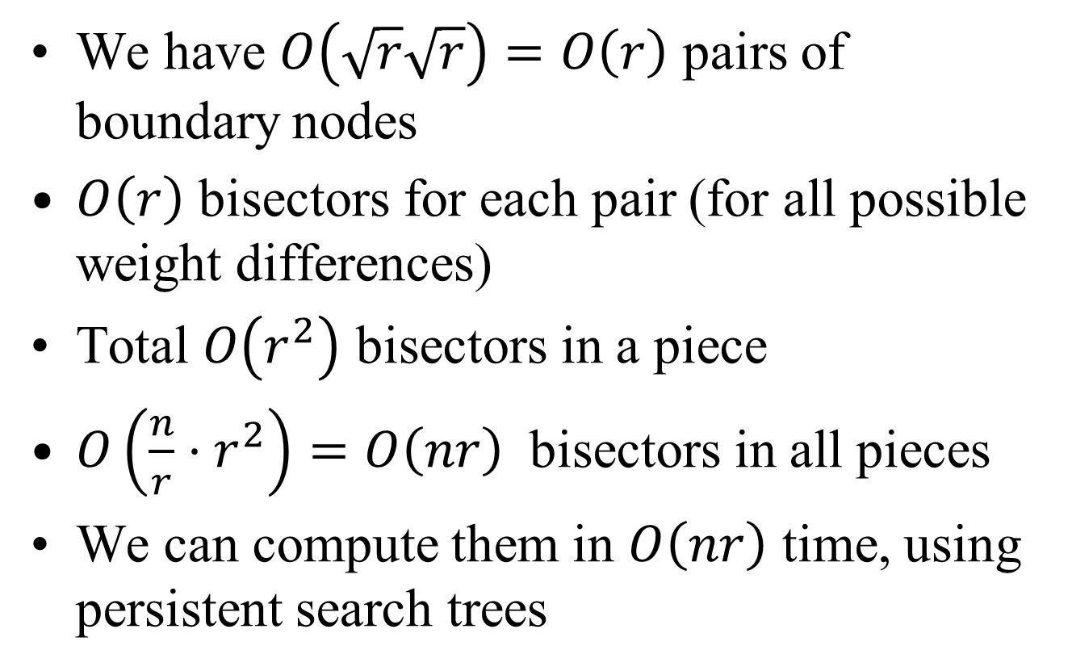
Bisectors
We have $O\left(\sqrt{r}\sqrt{r}\right)=O\left(r\right)$ pairs of boundary nodes
$O\left(r\right)$ bisectors for each pair (for all possible weight differences)
Total $O\left(r^{2}\right)$ bisectors in a piece
$O\left(\frac{n}{r}⋅r^{2}\right)=O\left(nr\right)$ bisectors in all pieces
We can compute them in $O\left(nr\right)$ time, using persistent search trees

Slide 54
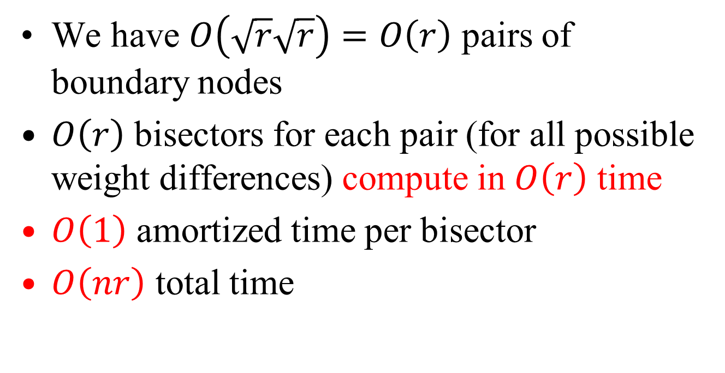
Computing the bisectors
We have $O\left(\sqrt{r}\sqrt{r}\right)=O\left(r\right)$ pairs of boundary nodes
$O\left(r\right)$ bisectors for each pair (for all possible weight differences) compute in $O\left(r\right)$ time
$O\left(1\right)$ amortized time per bisector
$O\left(nr\right)$ total time

Slide 55

Computing the Voronoi diagram
We compute the Voronoi-diagram from the bisectors in $O\left(\sqrt{r}\right)$ time by a divide and conquer algorithm

Slide 56
Basic building block
Finding Voronoi vertices
First, in a diagram of 3 sites

Slide 57
Diagram of 3 sites

Slide 58
Diagram of 3 sites
Lemma: It has at most 2 Voronoi vertices

Slide 59
At most 2 Vor. vertices
Proof:
?
Shortest paths cannot cross..

Slide 60
Computing the diagram of 3 sites

Slide 61
A diagram of 3 sites

Slide 62
A diagram of 3 sites

Slide 63
A diagram of 3 sites

Slide 64
A diagram of 3 sites

Slide 65
A diagram of 3 sites

Slide 66
A diagram of 3 sites

Slide 67
A diagram of 3 sites

Slide 68
A diagram of 3 sites

Slide 69
A diagram of 3 sites

Slide 70
A diagram of 3 sites

Slide 71
A diagram of 3 sites

Slide 72
A diagram of 3 sites
The blue site takes over an interval of the red/green bisector
The Voronoi vertices are the endpoints of this interval
We can find them by a binary search along the red/green bisector
Generalizes to a situation where instead of a single red/green/blue site we have a contiguous sequence of red/green/blue sites

Slide 73
Voronoi diagram
Traversing all triples of sites and finding the associated vertices is too expensive
Use divide and conquer

Slide 74
Divide and conquer

Slide 75
Divide and conquer

Slide 76
Divide and conquer

Slide 77
Divide and conquer

Slide 79


$$v$$
$$w$$

Slide 80
Divide and conquer

Slide 81
Max distance computation

Slide 82
Max distance computation

Slide 83
Max distance computation

Slide 84
Max distance computation

Slide 85
Max distance computation

Slide 86
Max distance computation

Slide 87
Max distance computation
Each dual vertex computes the max in its triangle
Vertices of the cotree compute subtree maxima
Gets somewhat more complicated in the presence of holes

Slide 88
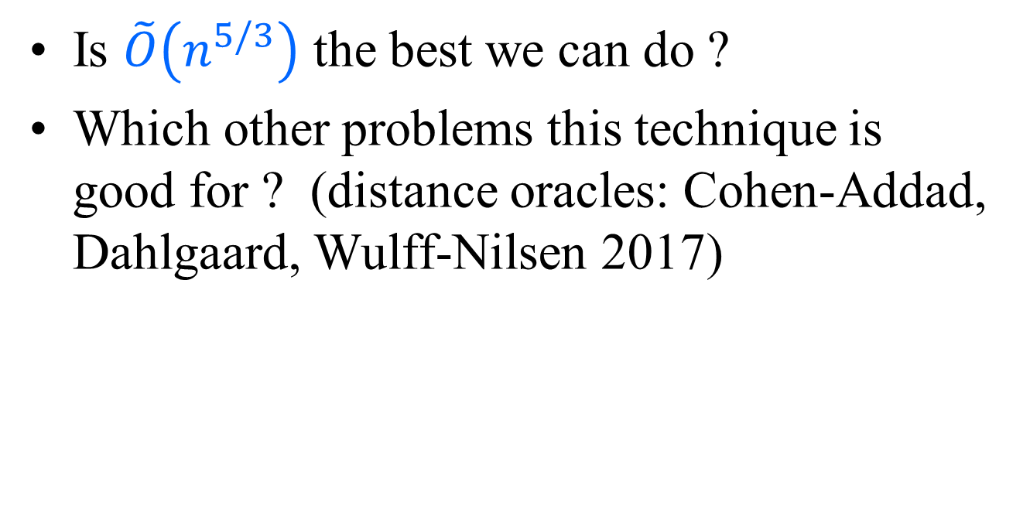
Open problems
Is $\tilde{O}\left(n^{5/3}\right)$ the best we can do ?
Which other problems this technique is good for ? (distance oracles: Cohen-Addad, Dahlgaard, Wulff-Nilsen 2017)

Slide 89
Thanks

Slide 91
Voronoi diagram

Slide 92
r-division

Slide 93
r-division

Slide 94
r-division

