Slide 1
Symboltabelle und Quadrupel
Vorgetragen von Frank
Folien von Danny

Slide 2
Inhalt
Symboltabelle
Interfaces der Symboltabelle
Quadrupel
Quellen

Slide 3
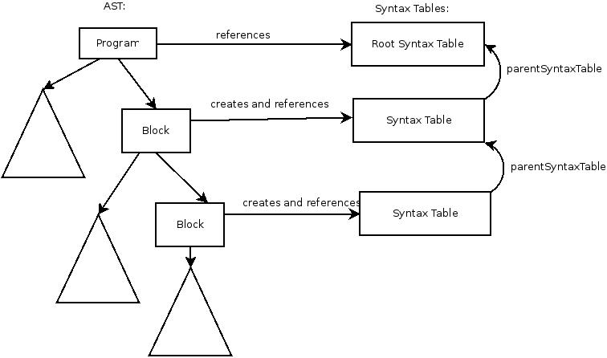
Symboltabelle

Slide 4
Interfaces der Symboltabelle
package swp_compiler_ss13.common.parser;
import swp_compiler_ss13.common.optimization.Liveliness;
import swp_compiler_ss13.common.types.Type;
public interface SymbolTable {
public SymbolTable getParentSymbolTable();
public Boolean isDeclared(String identifier);
public Type lookupType(String identifier);
public void insert(String identifier, Type type);
public Boolean remove(String identifier);
public void setLivelinessInformation(String identifier, Liveliness liveliness);
public Liveliness getLivelinessInformation(String identifier);
public String getNextFreeTemporary();
}

Slide 5
Quadrupel
op | arg1 | arg2 | res
plus | a | b | t
Warum Quadrupel und kein Tripel ?
Einfacher zu lesen
Leichter zu transformieren
public interface IntermediateCodeGenerator {
public Quadruple[] generateIntermediateCode(AST ast) throws IntermediateCodeGeneratorException;
}

Slide 6
Quellen
https://github.com/swp-uebersetzerbau-ss13/common/wiki/Symbol-Table
https://github.com/swp-uebersetzerbau-ss13/common/wiki/Intermediate-Code-Generator
https://github.com/swp-uebersetzerbau-ss13/common/issues/6
https://github.com/swp-uebersetzerbau-ss13/common/issues/1

