Slide 1
DHI-WASY Software Training Modeling Subsurface Flow and Transport using FEFLOW 7.1
Basic Models

Slide 2
Horizontal 2D Model - Flow

Slide 3
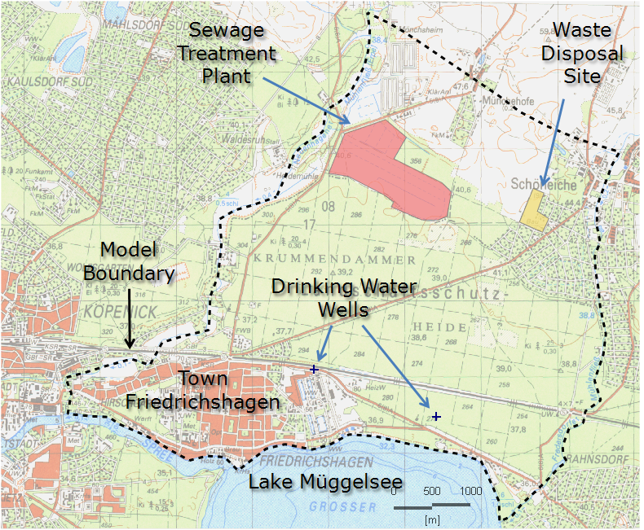
Friedrichshagen – Model Area

Slide 4
Friedrichshagen - Maps and Data Sources
File | Content | unit
topography_rectified.tif | Topographic map (for orientation) | -
model_area.shp | Outer model boundary | -
contamination_sources.dxf | Contamination Sources | -
wells.shp | Drinking water wells | -
File | Content | unit
elevations.dat | Surface elevation (all slices) | m ASL
sewage_plant.shp | Sewage plant site (3D data) | -
conc_init.shp | Initial concentration (slices 1,2) | mg/l
obs_points.shp | Observation points | -
File | Content | unit
year_rec.shp → MEAN_YEAR | Recharge for an average year | 10⁻⁴ m/d
conduc2d.shp → Value | Conductivity of aquifer 1 (layer 1) | 10⁻⁴ m/s

