Slide 2
Who are we?
Katinka Wolter Professor @ Institute of Computer Science Head of Joint Commission
Péter Koltai Professor @ Institute of Mathematics Head of Exam Board
Gregoire Montavan interim Professor @ Institute of Computer Science & Lecturer “ML4DS”
Sandro Andreotti Lecturer for “Programming for Data Science”
Henri Elad Altman Lecturer for “Statistics for DS”
Vikram Sunkara (ZIB), Katharina Jahn (FU), David Richter (FU), Katinka Wolter Lecturers for “Introduction to Profile Areas”
Sera Renée Zentiks …savvy in administration matters
Rubaisha Siddiqui
assistant

Slide 3
Today
Organisation
The Data Science Master Program
Q&A
Study regulations
Get together

Slide 4
Administration
Joint Commission
Head: K. Wolter Deputy H.: P. Koltai
Data Science
Examination Committee
Head: P. Koltai

Slide 5
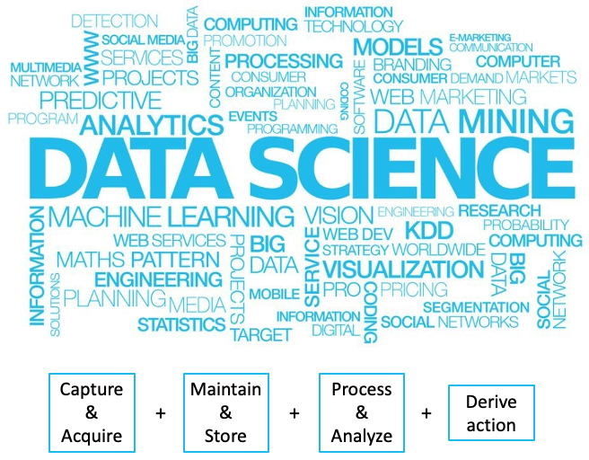

Slide 6
@
At FU you can focus on:
Data Science in the Life Sciences
Data Science Technologies
Data Science in the Social Sciences

Slide 7
The Data Science Master Program

Slide 8
The Aim of the Master Program (From the study regulations)
Graduates are familiar with the essential methods of modern data science and the associated mathematical, computer-science and subject-specific fundamentals.
They are able to analyse data analytical problems independently, to compare different methodological approaches and to assess their advantages and disadvantages.
Graduates will be able to formalise newly emerging data analysis problems mathematically, develop methods to solve them, implement them in an application-oriented manner and interpret them appropriately.

Slide 9
More specifically...
The graduates are able to carry out independent research and development activities in the field of data science in a profile-oriented manner.
Data Science in the Life Sciences
Data Science Technologies

Slide 10
Recommended Schedule
Semester 1
Semester 2
Semester 3
Semester 4
Foundation Courses (Statistics, Programming, Machine Learning)
Courses from Focus Area
Master Thesis with Colloquium
Courses NOT from FocusArea
Introduction to Focus Areas
Ethical Foundations
Research Internship (DSSS, DSLF) OR Software Project (DST)
Synchronization
Focus Area
Thesis
Data Science in the Life Sciences (DSLS)
Data Science Technologies (DST)
+ interdisciplinary modules (SS & others)

Slide 11
DS in Social Science
Mandatory:
– Modul: Data Science in the Social Sciences (15 LP)
- Modul: Forschungspraxis (10 LP).
- Modul: Ethical Foundations of Data Science (5 LP)
Elective compulsory courses
– Modul: – Modul: Neurocognitive Methods and Programming for Data Science (10 LP)
– Modul: Cognitive Neuroscience for Data Science A (10 LP)
– Modul: Cognitive Neuroscience for Data Science B (10 LP)
– Modul: Differentialpsychologische Ansätze in den Data Sciences (10 LP)
– Modul: Natural Language Processing (10 LP)
– Modul: Einführung in die Psychoinformatik (5 LP)
– Modul: Mobile Mental Health (5 LP)
– Modul: Entwicklung von psychologischen Online-Interventionen (10 LP)
– Modul: Ausgewählte Themen der Data Science in the Social Sciences (5 LP)
– Modul: Spezielle Aspekte der Data Science in the Social Sciences (5 LP)

Slide 12
DS in Life Science
Mandatory:
– Modul: Data Science in the Life Sciences (15 LP),
– Modul: Forschungspraxis (10 LP)
– Modul: Ethical Foundations of Data Science (5 LP)
Elective compulsory courses
– Modul: Spezielle Aspekte der Data Science in Life Sciences (5 LP)
– Modul: Ausgewählte Themen der Data Science in Life Sciences (10 LP)
– Modul: Maschinelles Lernen in der Bioinformatik (5 LP)
– Modul: Analyse großer Datensätze in der Bioinformatik (5 LP)
– Modul: Netzwerkanalyse (10 LP)

Slide 13
DS Technologies
Mandatory:
– Modul: Softwareprojekt Data Science (10 LP)
– Modul: Ethical Foundations of Data Science (5 LP)
Elective compulsory courses
– Modul: Spezielle Aspekte der Data Science Technologies (5 LP)
– Modul: Aktuelle Forschungsthemen der Data Science Technologies (5 LP)
– Modul: Ausgewählte Themen der Data Science Technologies (10 LP)
– Modul: Datenbanksysteme Data Science (5 LP)
– Modul: Verteilte Systeme (5 LP)
– Modul: Mobilkommunikation (5 LP)
– Modul: Telematik (10 LP)
– Modul: Höhere Algorithmik (10 LP)
– Modul: Rechnersicherheit (10 LP)
– Modul: Mustererkennung (5 LP)
– Modul: Netzbasierte Informationssysteme (5 LP)
...

Slide 14
The First Semester Schedule (winter 21/22)
 | Monday | Tuesday | Wednesday | Thursday | Friday
08-10 |  | Statistics (T) |  |  | ML (T)
10-12 | Statistics (L)
12-14 | Programming |  |  | ML (L) | Intro Focus Areas (L)
14-16 | Programming |  |  |  | Intro Focus Areas (P)
16-18 |  | ML (L) | ML (T)
L: Lecture T: Tutorial
P: Practical Seminar

Slide 15
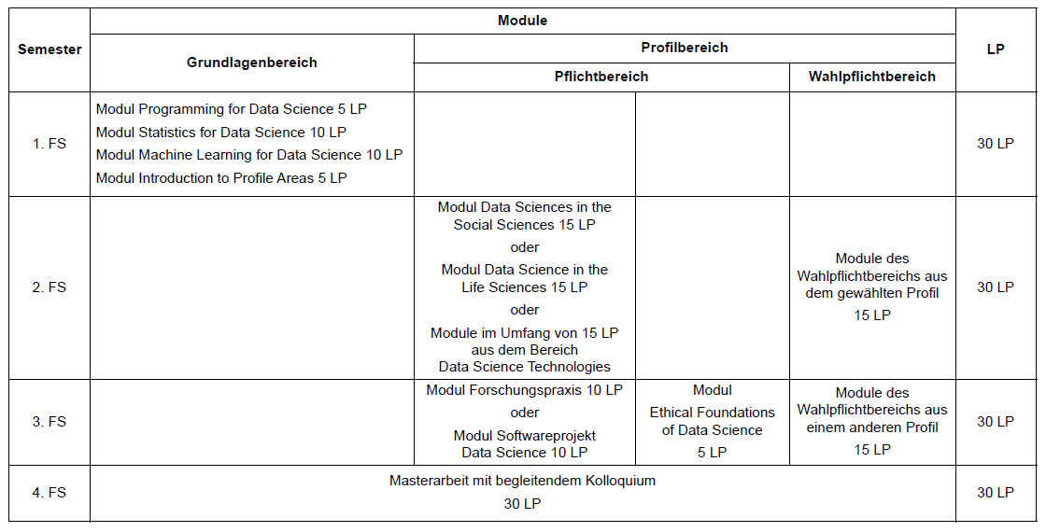
Recommended Schedule

Slide 16
Important note
Most study programmes in Germany (such as DS @ FU) are free of charge. The main difference to tuition-based programmes is that you (as the student) are responsible for your progress.
Everyone is happy to provide support when asked, but no one is monitoring you.

Slide 17
Other Support @ FU Berlin

Slide 18
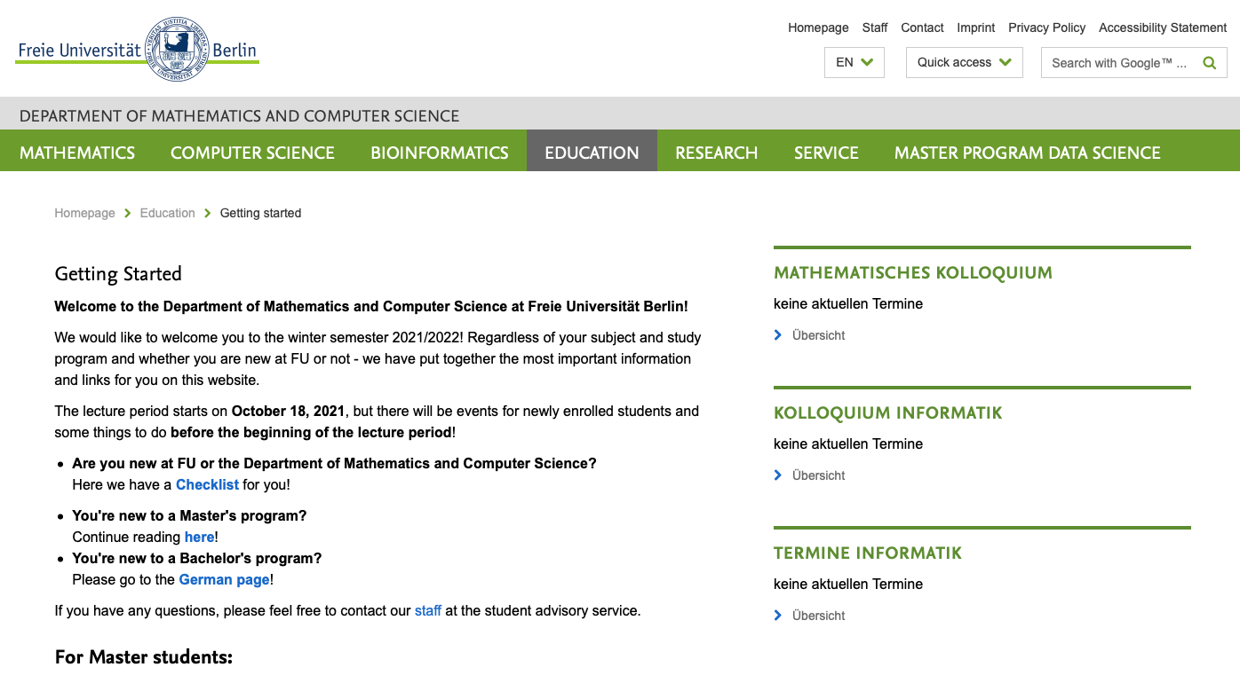
https://www.mi.fu-berlin.de/en/stud/studienanfaenger.html

Slide 19
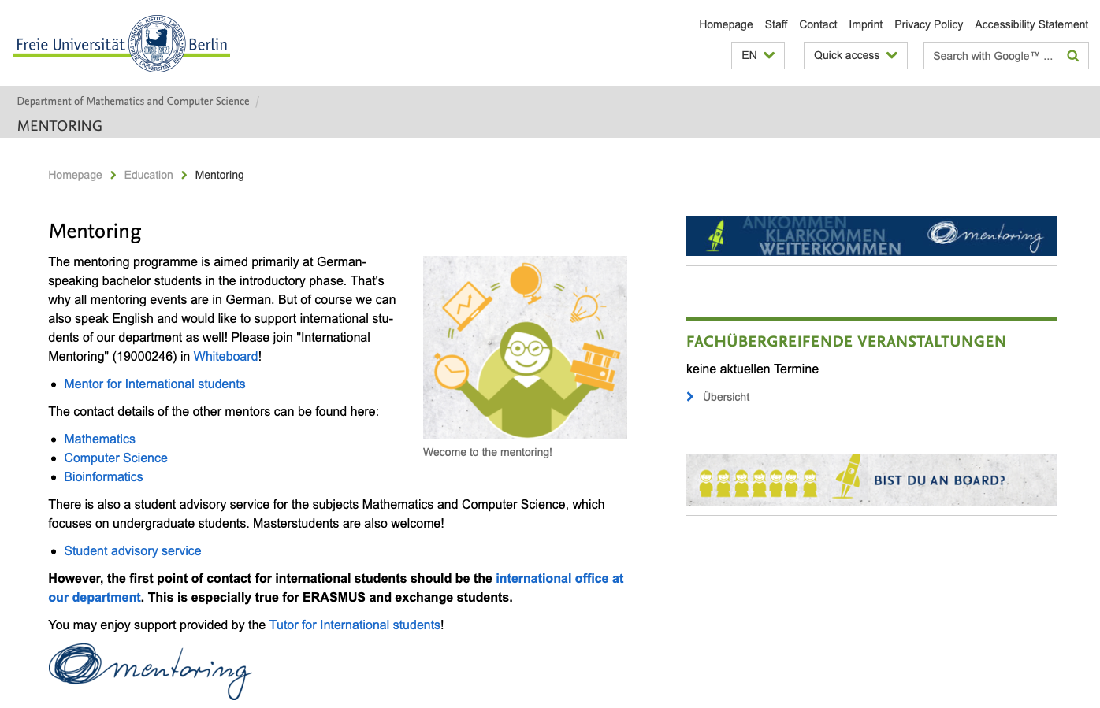
https://www.mi.fu-berlin.de/en/stud/mentoring/index.html

Slide 20
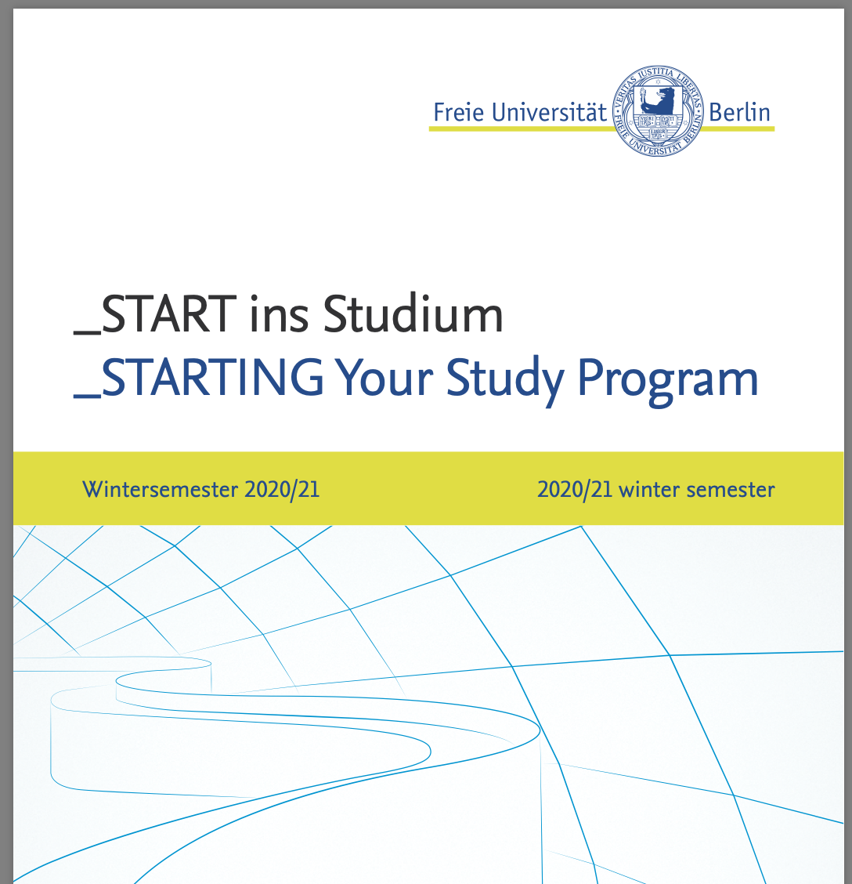
https://www.fu-berlin.de/studium/docs/DOC/_START-ins-Studium.pdf

Slide 21
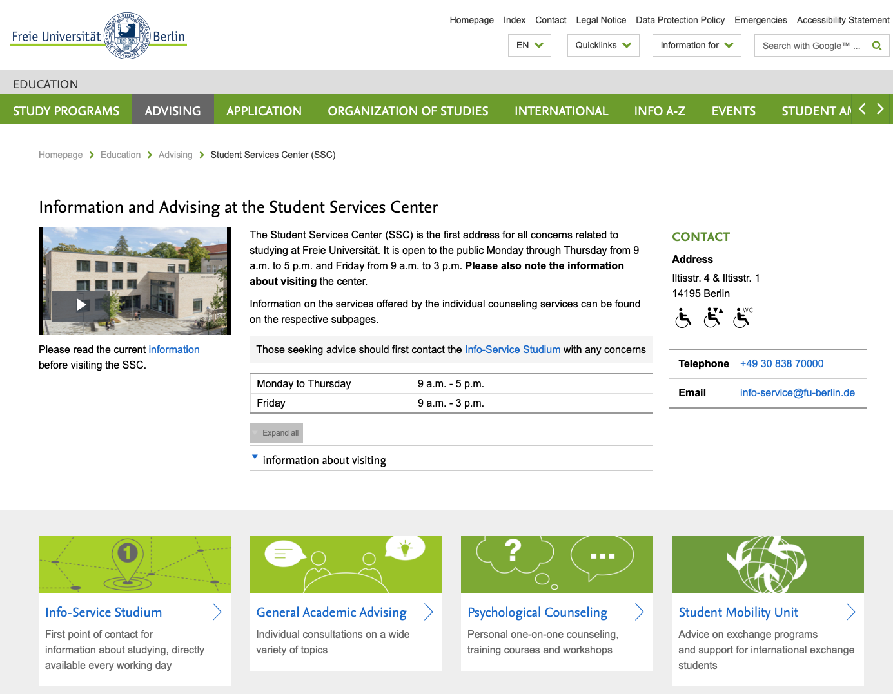

Slide 22
