Slide 1


Slide 2
Katinka Wolter
Professor @ Institute of Computer Science
Head of Joint Commission
Claudia Schillings
Professor @ Institute of Mathematics
Head of Exam Board
Tim Landgraf (FU), Jianing Li (ZIB), Paul Hagemann (BAM)
Lecturers “ML4DS”
Sandro Andreotti
Lecturer for “Programming for Data Science”
Guilherme de Lima Feltes
Lecturer for “Statistics for DS”
Katharina Baum (FU), Nils Körber (RKI), Katinka Wolter
Lecturers/Organisers for “Introduction to Profile Areas”
Emmelie Korell
Coordinator of the international MSc programs
Who are we?

Slide 3
Today
Organisation
The Data Science Master Program
Study regulations
Q&A
Networking

Slide 4
Administration
Joint Commission
Head: K. Wolter
Deputy H.: Max v. Kleist
Data Science
Examination Committee
Head: Claudia Schillings

Slide 5
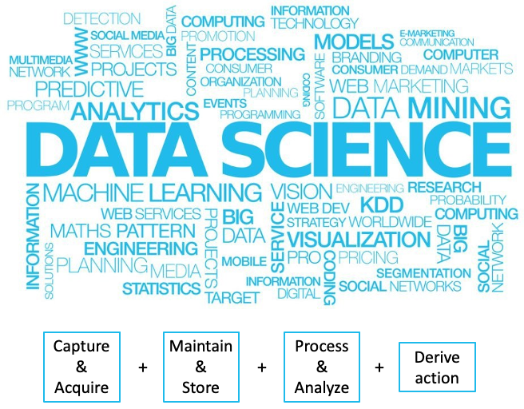

Slide 6


@
At FU you can focus on:
Data Science in the Life Sciences
Data Science Technologies
A bit of anything you like

Slide 7
The
Data Science Master Program

Slide 8
The Aim of the Master Program
(From the study regulations)
Graduates are familiar with the essential methods of modern data science and the associated mathematical, computer-science and subject-specific fundamentals.
They are able to analyse data analytical problems independently, to compare different methodological approaches and to assess their advantages and disadvantages.
Graduates will be able to formalise newly emerging data analysis problems mathematically, develop methods to solve them, implement them in an application-oriented manner and interpret them appropriately.

Slide 9
More specifically...
The graduates are able to carry out independent research and development activities in the field of data science in a profile-oriented manner.
Data Science in the Life Sciences
Data Science Technologies

Slide 10
The
Program Structure

Slide 11
Recommended Schedule
Semester 1
Semester 2
Semester 3
Semester 4
Foundation Courses
(Statistics, Programming, Machine Learning)
Courses from Focus Area
Master Thesis
with Colloquium
Courses NOT from FocusArea
Introduction to Focus Areas
Ethical Foundations
Research Internship
(DSSS, DSLF) OR
Software Project (DST)
Basics
Profile (Focus Area + Topics of Interest)
Thesis
Data Science in the Life Sciences (DSLS)
Data Science Technologies (DST)
+ interdisciplinary modules (Social Sciences & others)

Slide 12
Focus Area: DS in Life Science
Mandatory:
Modul: Data Science in the Life Sciences (15 LP),
Modul: Forschungspraxis (10 LP)
Modul: Ethical Foundations of Data Science (5 LP)
Elective courses
– Modul: Spezielle Aspekte der Data Science in Life Sciences (5 LP)
– Modul: Ausgewählte Themen der Data Science in Life Sciences (10 LP)
– Modul: Maschinelles Lernen in der Bioinformatik (5 LP)
– Modul: Analyse großer Datensätze in der Bioinformatik (5 LP)
– Modul: Netzwerkanalyse (10 LP)

Slide 13
Mandatory:
– Modul: Softwareprojekt Data Science (10 LP)
– Modul: Ethical Foundations of Data Science (5 LP)
Elective courses
– Modul: Spezielle Aspekte der Data Science Technologies (5 LP)
– Modul: Aktuelle Forschungsthemen der Data Science Technologies (5 LP)
– Modul: Ausgewählte Themen der Data Science Technologies (10 LP)
– Modul: Datenbanksysteme Data Science (5 LP)
– Modul: Verteilte Systeme (5 LP)
– Modul: Mobilkommunikation (5 LP)
– Modul: Telematik (10 LP)
– Modul: Höhere Algorithmik (10 LP)
– Modul: Rechnersicherheit (10 LP)
– Modul: Mustererkennung (5 LP)
– Modul: Netzbasierte Informationssysteme (5 LP)
Focus Area: DS Technologies

Slide 14
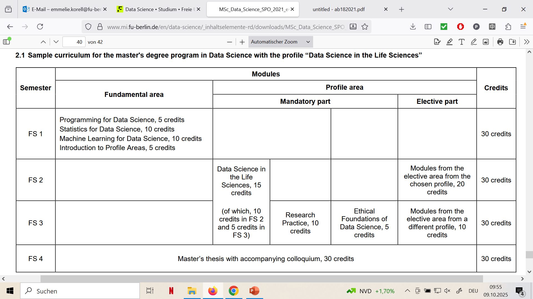

Slide 15
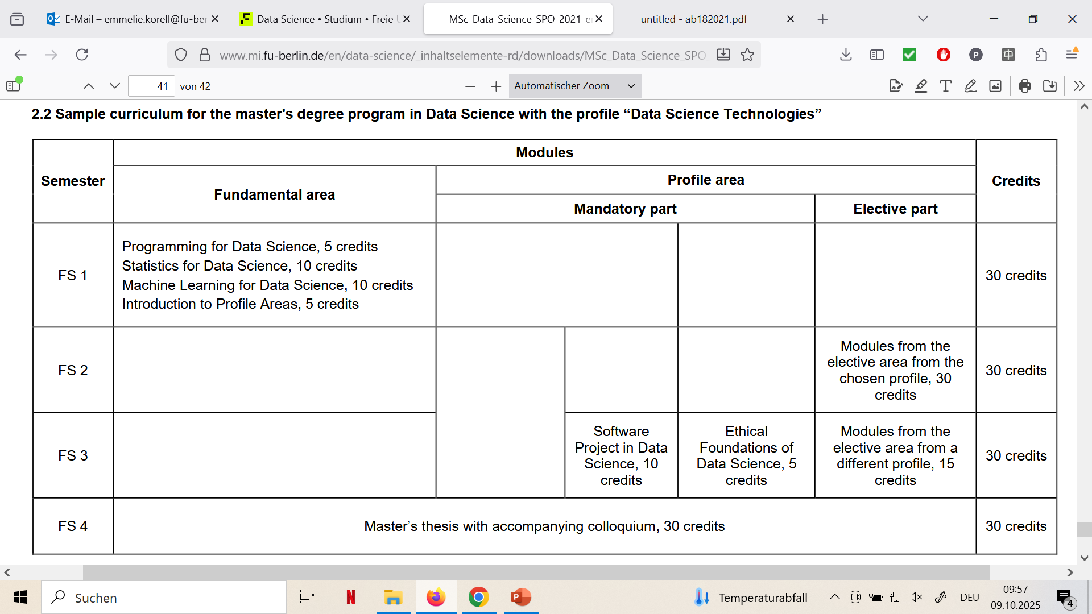

Slide 16
Selected Formalities
Attendance: attendance is often mandatory for tutorials, not for lectures (but recommended)
Exams: may usually be repeated twice.
Sign-ups: enrollment is through campus management (unless otherwise specified). 1st semester courses have enough spots for DS students

Slide 17
Course Recognitions
Recognition of courses from a previous Bachelor degree: possible. Up to 15 credits may be recognized. Needs to be approved by the examination board. Not recommended for foundation courses.
Recognition of Master-level courses from other departments or universities: possible. Needs to be approved by the examination board.
Recognition of subject-related Master-level courses from different disciplines. possible. Needs to be approved by the examination board.
Before reaching out to the examination board, reach out to the coordination!

Slide 18
Important note
Most study programmes in Germany (such as DS @ FU) are free of charge. The main difference to tuition-based programmes is that you (as the student) are responsible for your progress.
Everyone is happy to provide support when asked, but no one is monitoring you.

Slide 19
Contact Points

Slide 20
Who to ask?
First point of contact: Emmelie Korell
For issues related to courses: your instructor
For issues related to course recognition: Claudia Schillings
For organising certificates, MSc thesis sign-up: Maria Kökenhoff
For wishes regarding the teaching program: Katinka Wolter

Slide 21
Other Support
@ FU Berlin

Slide 22
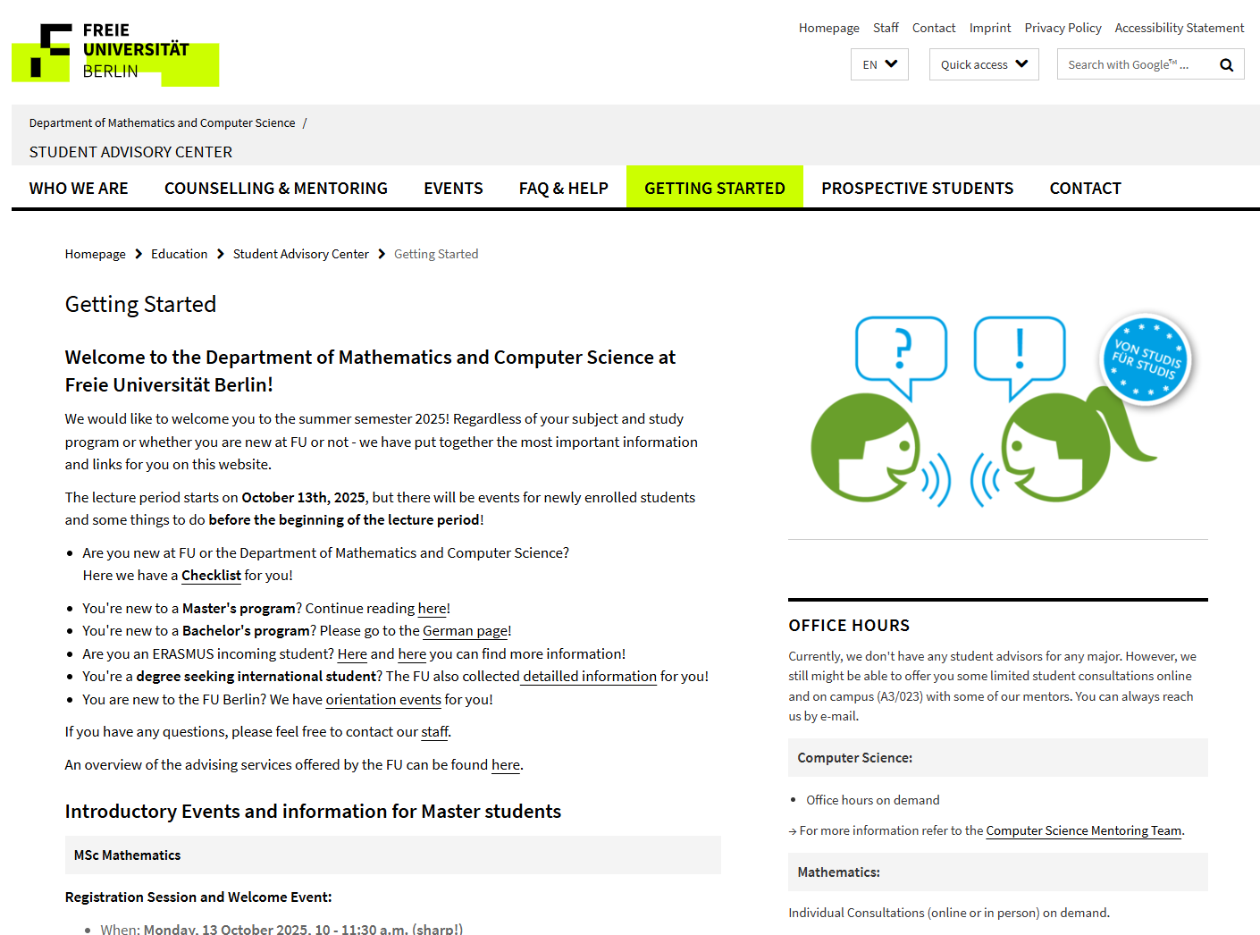
https://www.mi.fu-berlin.de/stud/beratungszentrum/studienstart/index.html

Slide 23
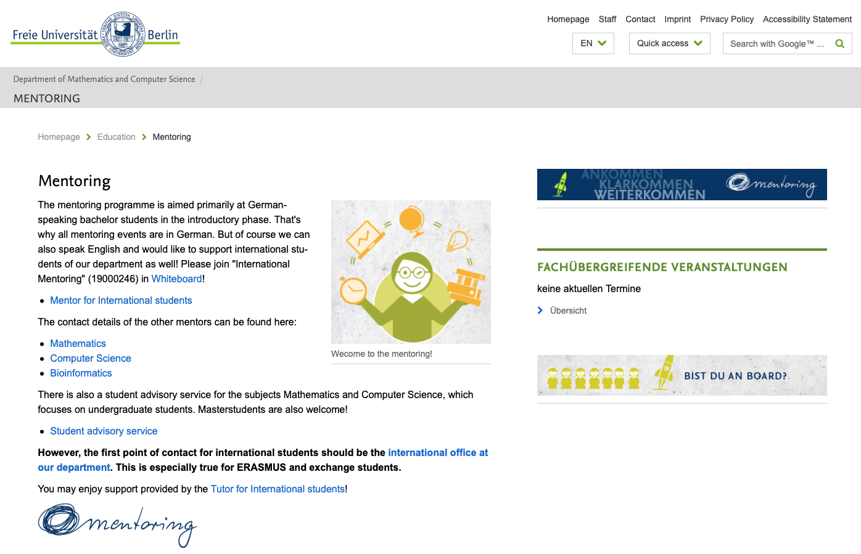
https://www.mi.fu-berlin.de/en/stud/mentoring/index.html

Slide 24
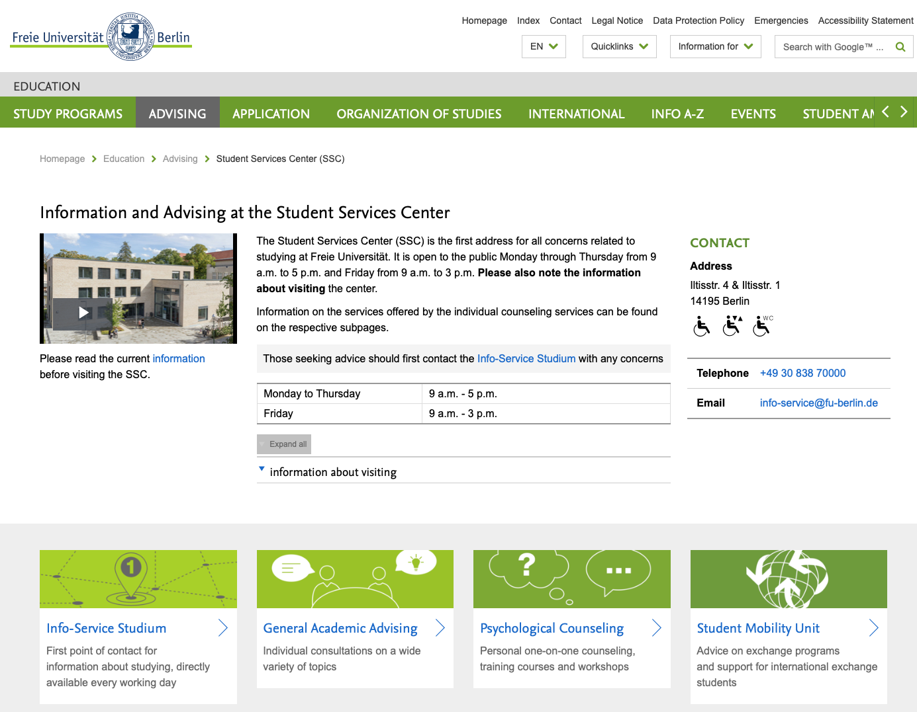

Slide 25


Slide 26
The First Semester Schedule
(winter 25/26 – October 13-17)
 | Monday | Tuesday | Wednesday | Thursday | Friday
8-10
10-12 | Welcome Session | Statistics Lecture | Programming for DS | Programming for DS | Programming for DS
12-14 | Programming for DS | Programming for DS | Machine Learning Lecture
14-16 |  |  | Programming for DS | Machine Learning Lecture
16-18

Slide 27
The First Semester Schedule
(winter 25/26 – October 20-25)
 | Monday | Tuesday | Wednesday | Thursday | Friday
8-10
10-12 | Statistics Lecture | Statistics Practical | Programming for DS | Programming for DS | Programming for DS
12-14 | Programming for DS | Programming for DS | Machine Learning Lecture
14-16 | Machine Learning Practical |  | Programming for DS | Machine Learning Lecture
16-18 | Programming for DS

Slide 28
The First Semester Schedule
(winter 25/26 – October 27- November 21)
 | Monday | Tuesday | Wednesday | Thursday | Friday
8-10
10-12 | Statistics Lecture | Statistics Lecture
12-14 |  | Programming for DS | Machine Learning Lecture
14-16 | Machine Learning Practical |  |  | Machine Learning Lecture | Introduction to Profile Areas Lecture
16-18 |  |  |  |  | Introduction to Profile Areas Seminar

Slide 29
The First Semester Schedule
(winter 25/26 – November 28 – end of term)
 | Monday | Tuesday | Wednesday | Thursday | Friday
8-10
10-12 | Statistics Lecture | Statistics Lecture
12-14 |  | Programming for DS | Machine Learning Lecture |  | Introduction to Profile Areas Lecture
14-16 | Machine Learning Practical |  |  | Machine Learning Lecture | Introduction to Profile Areas Seminar
16-18

Slide 30
Online & hybrid (2025)
Programming for Data Science: online
Introduction to Profile Areas: hybrid until end of year
Statistics for Data Science: remote possible; contact lecturer
Machine Learning for Data Science: remote possible, however, no specialized offers

Slide 31
Useful links
Campus management
  Course registration, de-registration, grades, etc.
  https://www.fu-berlin.de/en/sites/campusmanagement/index.html
Whiteboard
  Course materials, announcements
  https://mycampus.imp.fu-berlin.de/x/VxSEhG
Blackboard (used by other departments)
  Course materials, announcements
  https://fu-berlin.blackboard.com/

