Slide 1
The Data Attribution
Abdul Saboor PhD Research Student
abdul.saboor@fu-berlin.de
Model Base Development and Software Quality Assurance
Research Group
Freie University Berlin
Takustr.9, Berlin,
Germany
2nd International Open Data Dialog
Berlin, Germany
November 19th 2013

Slide 2
Main Contents for the Presentation
The Data Attribution
The Applications/Use of Attribution
The Attribution Model Scope
The Attribution Model for Open Data
Techniques for Data Attribution
The Mechanism for Data Attribution
Conclusion
1

Slide 3
Why Data Attribution?
Problem Statement for
Data Attribution
Invented Solution for
Data Attribution
Develop an efficient infrastructure that make this possible to verify the source of Dataset(s). The platform allows to manage the life-cycle of an dataset(s) its creation, modification and expiration into the system and platform should allows to trace the origin of each dataset and visualize graphically.
Developed a model TAMOD (The Attribution Model for Open Data) and introduced a model theory to support the solution.
Techniques are used to define the model process and efficiency.
Mechanism is defined in order to implement and test the model approach.
The Data Attribution 2

Slide 4
What is Data Attribution?
The “Attribution” is to give credit or to acknowledge the Author/Creator of some Data while using that data for some purposes.
The act of Attribution is defined as to establish a relationship/link to the data which operates from one artifact to another artifact (the Creator and the User of that data). Keeping the track record of data from beginning to end.
The Data Attribution 3

Slide 5
What is Data Attribution?
Data Attribution is mainly used for acknowledging the Data Creator(s) and indicating the availability of Data .
Crediting Author(s)
It has to be ensured that the Credit is given to those authors who created that data
Granularity
It refers to the attributes or features that the datasets contain.
Versions of Dataset
The dataset(s) which are regularly updated that needs to be attributed against its each newer version.
Location of the Dataset
It refers to the persistent link which actually refers to the dataset(s) such as Digital Object Identifier, Deep Links.
The Applications/Use of Data Attribution 4

Slide 6
The Applications/Use of Data Attribution
Data Quality
All mandatory elements of Data Attribution must be filled out for each dataset in order to ensure the completeness and correctness of every single dataset.
Data Relevance
It is analyzed that the metadata information is exactly according to the submitted dataset(s), e.g. various attributes and description of data fields.
Data Trustworthiness
Evaluate the Quality criteria such as data quality (check the ratio of blank nodes), perform tests to measure the correctness (codes) and efficiency on datasets.
The Applications/Use of Data Attribution 5

Slide 7
The Applications/Use of Data Attribution
Data Provenance
Track the history of datasets so that the origin/source of datasets can be traced and also various transformational stages of datasets.
Intellectual Property
Establish the Rights and Ownerships for the dataset(s). Three points: What rights are associated?, Who Owns the datasets?, How open are the dataset(s)?
Informational
Discover and reuse the datasets, understanding or analyzing what work has done before, and how a subject changing over the period of time (History and Transformational Stages).
The Attribution Model Scope 6
Notes:
Associated Rights for the Datasets – Reuse, Reproduce, Attribute

Slide 8
The Attribution Model Scope
To manage the attribution data in the platform for keeping complete track record for the shared datasets through attribution model.
To define the model in a precise and efficient way so that it can manage the datasets transformation process during the life-cycle of dataset.
To support all kinds of representations of attribution during the process from one artifact to another artifact.
To allow developers to operate, build and share tools that can be integrated with the model.
To define the core set of rules that can express the valid interfaces for attribution data and workflow process with graphs.
TAMOD Classifies Nodes into Five Parts 7

Slide 9
Model Theory - TAMOD Classifies Nodes into Five Parts
Artifact
Metadata
Actions
A fixed value Dataset which represent an Entity in a given State.
A description about the dataset, its elements and representation format.
Types of Operation that are performed on various dataset(s).
Workflow/Process
Agents
Performed on an artifact in order to create another artifact.
Indicate Entities that are controlling the processes such as Data Steward, Platform Administrator, Data Accessor.
The Attribution Model for Open Data (TAMOD) – 1 8

Slide 10
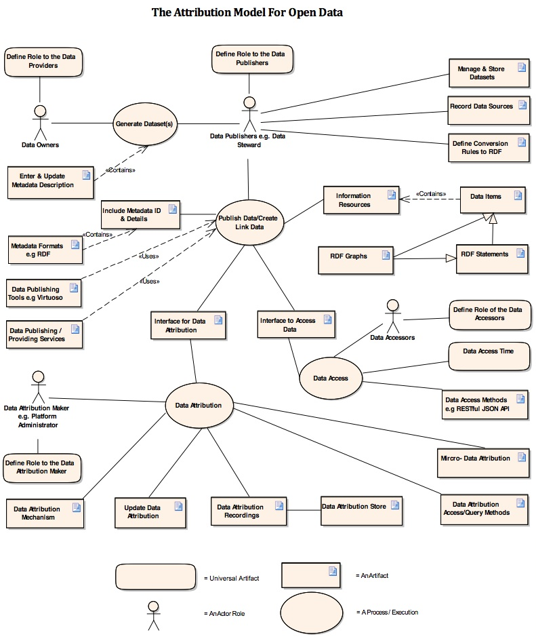
The Attribution Model for Open Data (TAMOD) - 1
1
2
4
3
6
5
Techniques for Data Attribution 9

Slide 11
Techniques for Data Attribution
1 – Descriptive Attribution or Indirect-Data Attribution – It is used to record all kinds of modifications and certain operations that are performed by Data Accessor/User on the dataset(s).
2 – Direct Attribution or Micro-Data Attribution – It is used to make the data attribution process efficient
Crediting/Acknowledging the Authors/Creators of Dataset(s) into a more compact way in order to make the process more manageable, efficient and consistent for building/establishing relationship.
Exclude the Organization or its department personnel whose role don’t fit for the role of data Creator or Compiler.
Unique Identifiers are used for both Contributors and Contribution to reduce/compress the irrelevant entities or least important entities, a table can be used for supplementary data.
Levels of Modification for Micro-Data Attribution 10

Slide 12
Level of Data Modifications For Micro Data Attribution
Different Levels of Modification that needs to be consider in order to implement the Micro-Data Attribution Technique
Low Level
Basic modification in dataset or its fields that doesn’t impact on the health of dataset.
Intermediate Level
Modify some data or data fields, enter some new data and description. Consider the level of impact on data health.
Higher Level
Perform major changes in dataset or data attributes, and modifying the definition of data.
The Attribution Model for Open Data (TAMOD) – 2 11

Slide 13
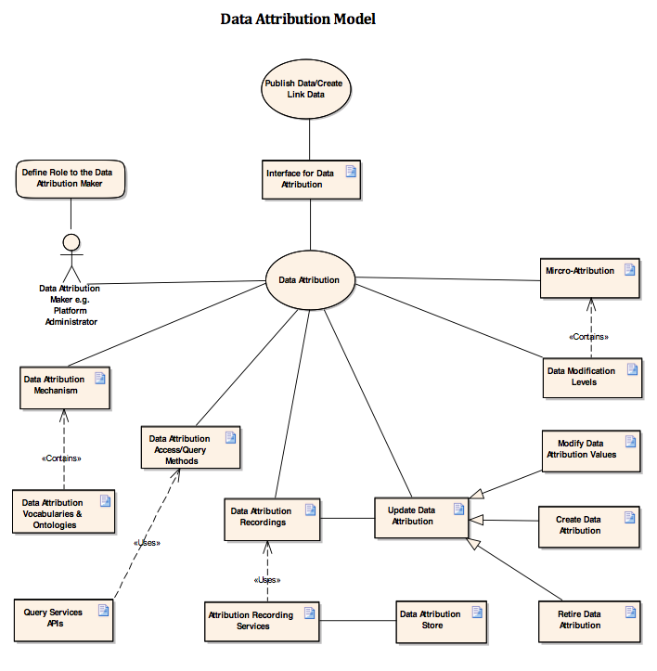
The Attribution Model for Open Data (TAMOD) - 2
3
1
2
The Mechanism for Data Attribution 12

Slide 14
The Mechanism for Source Data Attribution
Main features to define the Mechanism for the Source Data Attribution
Apply Checksum for every dataset or each version of dataset such as SHA-1, SHA-2, etc.
Apply Digital Signatures for RDF datasets
Signature verification for RDF dataset(s)
Integrity Assurance
Result Verification
The attribution elements for Public Key is to describe the creation date, modification/expiry date
Attribution-Aware Data Querying 13

Slide 15
Attribution-Aware Data Querying
Data feeds are associated with certain attribution metadata such as data source, data creator/publisher, creation/publication date, modified date, data version, etc.
Attribution-aware data querying taking this concept into the consideration of data attribution implemented by some Govt. Institutes or Organizations, and how they are handling the system of Data Attribution?.
LIVE DEMO – Some Govt. Datasets Concrete Results that are obtained through SPARQL Queries Execution for analyzing data attribution process management.
Conclusion 14

Slide 16
Conclusion
The Data Attribution model describes the life-cycle of datasets such as Creating Link Data, Include Metadata Information, Data Access and Data Attribution Process.
For making the Attribution more efficient it has to analyzed the level of modification that are performed on datasets.
Micro-Data Attribution techniques is used to make the data Attribution more efficient.
Data Attribution mechanism maintain the Quality and Integrity of Datasets, previous works can be verified and reused.
15

Slide 17
Thanks for paying attention!
Any Questions, Please?
The End

