Slide 1
PMSB Project: RNA-Seq Read Simulation

Slide 2
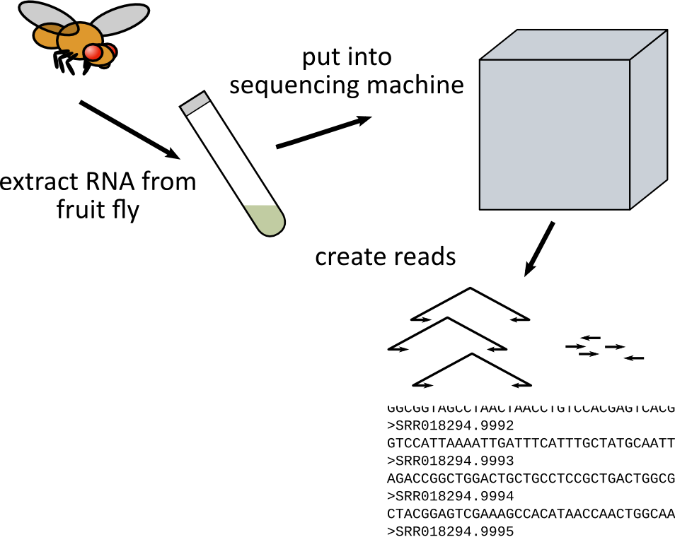
Overview
The actual process of RNA-Seq is quite involved
For simple simulation, we can break it down to two steps:
Simulate splicing of genes in the organism
Simulate sampling process by the sequencing machine.

Slide 3
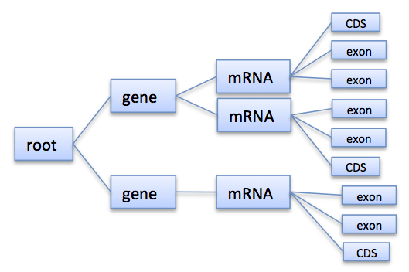
Part A: Simulate Splicing
Read in:
Reference Sequence
Gene/Exon/Intro annotation from GFF (GTF File)
Generate transcriptome of organism
For each gene
For each mRNA
Splice together sequences from genome
Write out transcriptome to FASTA File

Slide 4
Part B: Read Simulation
Read in
Reference sequence (transcriptome)
Read in expression levels (aka counts) for each transcript
Simulate Reads
Single-End: Sample uniformly with fixed length.
Paired-End: Sample paired, insert size follows normal distribution.
Error Model: Uniform Errors
Error Model: Read in FASTQ files, convert quality values into error probabilities, use this form position dependent errors.
Write out simulated reads

